Slide 1
Presentation
UNIMAN ENGLIS, s.r.o.

Slide 2
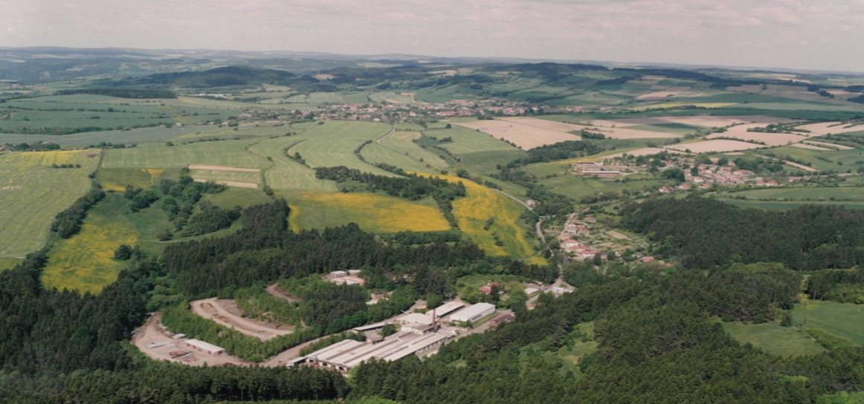
UNIMAN have residence in Velke Tresne in the district Zdar nad Sazavou in Vysocina region.
1.0
INFORMATION
In the picture is UNIMAN facility, it consists of 4 production halls, offices and storage areas.

Slide 3
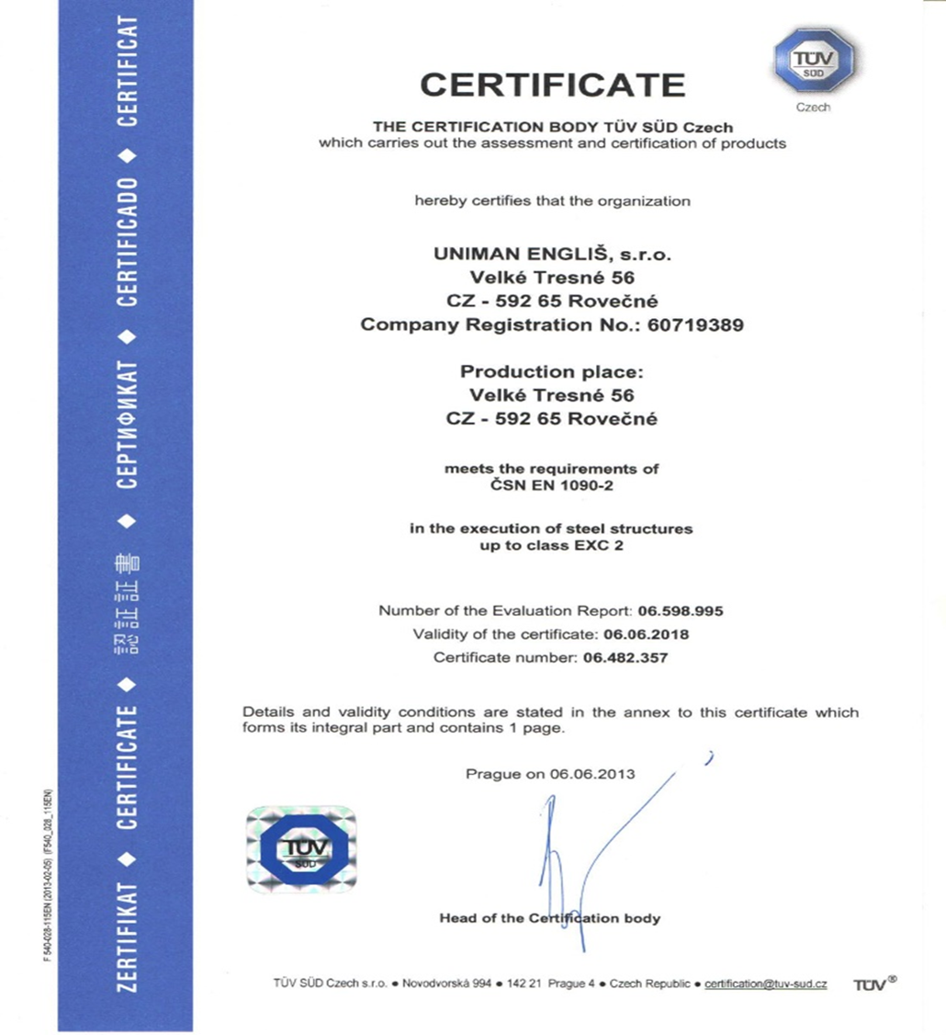
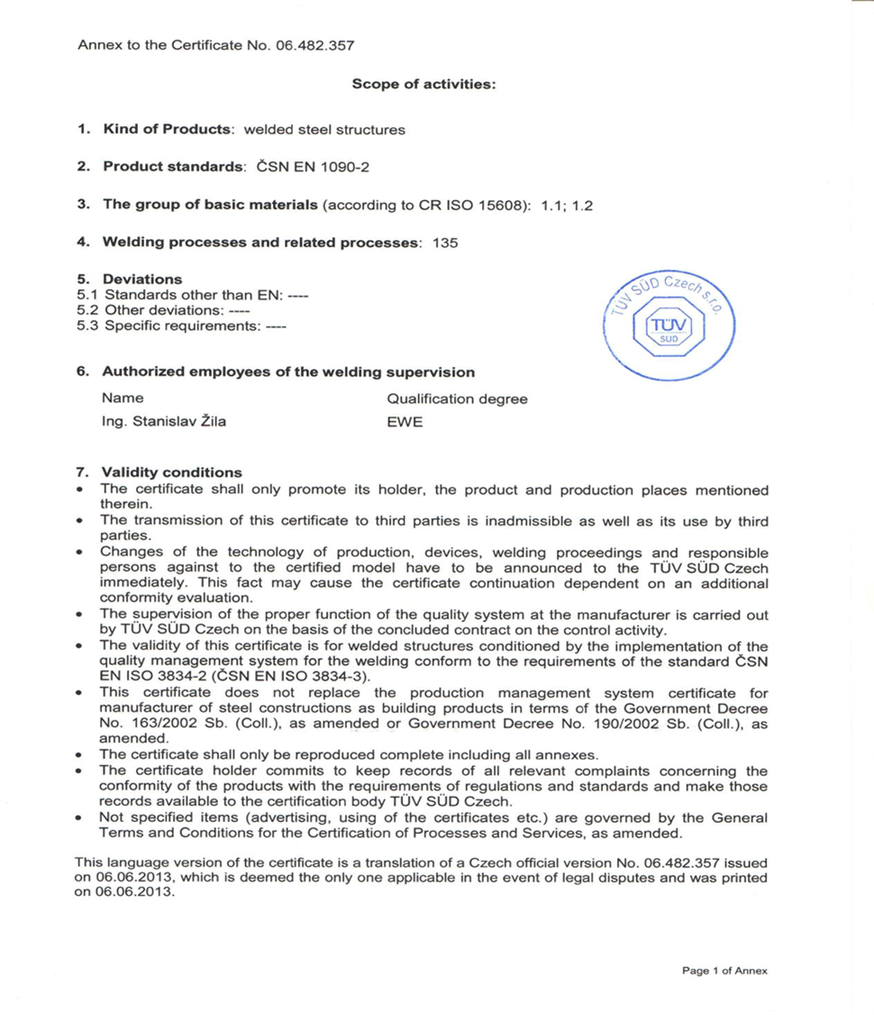
2.0
CERTIFICATE

Slide 4
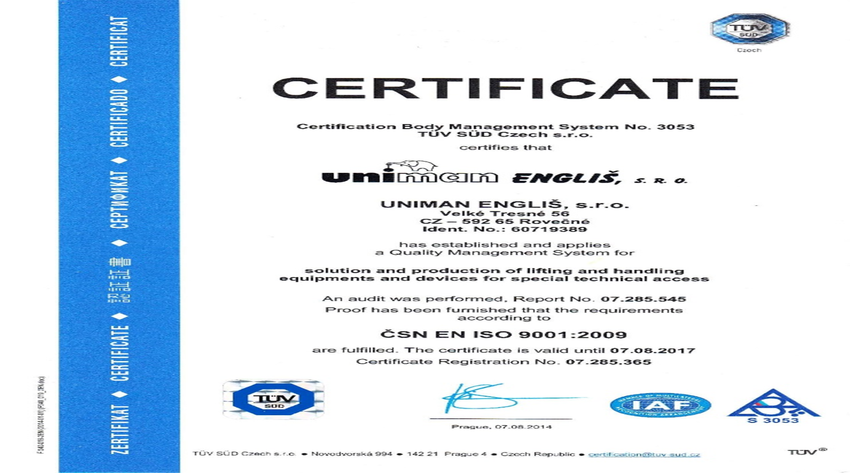

Slide 5
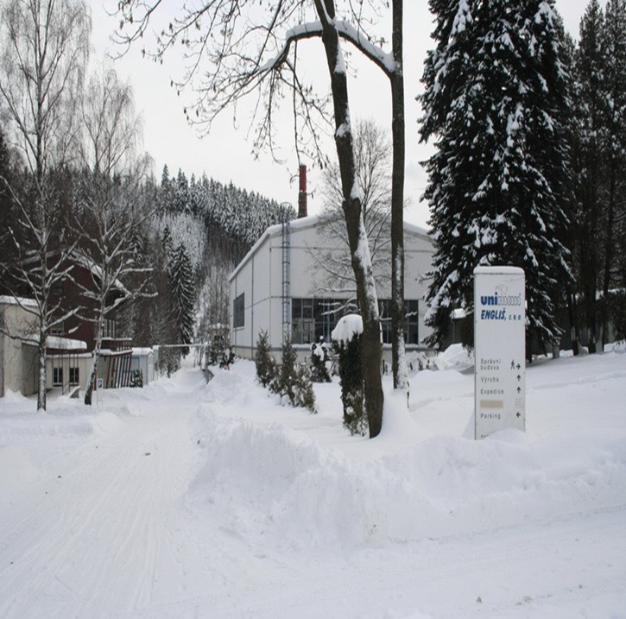
3.0
PRODUCTS
3.1 BEAMS
3.2 SPECIAL LIFTING GRIPPER
3.3 FORK HINGES ON EURO PALLETS
3.4 CRANES
3.5 LIFTING GRIPPER FOR BARRELS
3.6 LIFTING GRIPPER FOR COIL
3.7 RAMPS

Slide 6
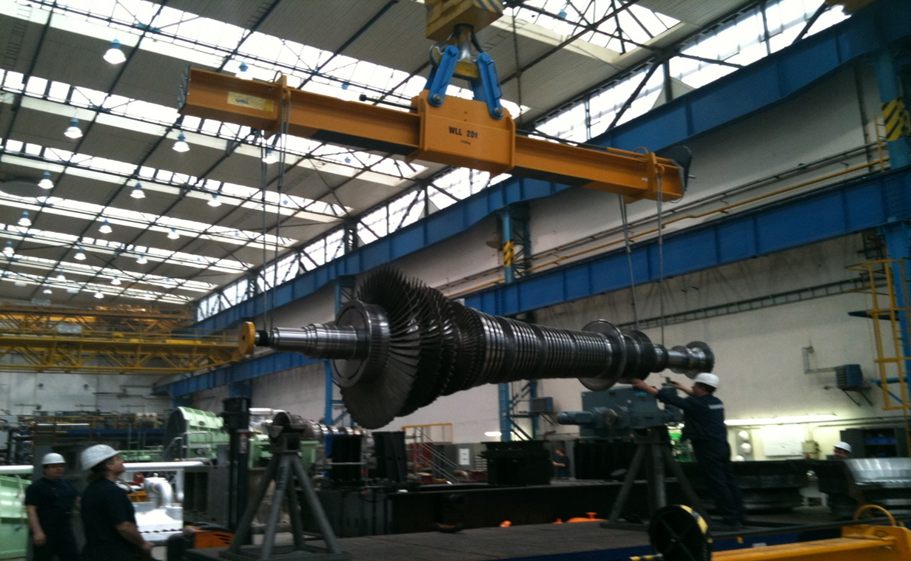
3.1
BEAMS

Slide 7
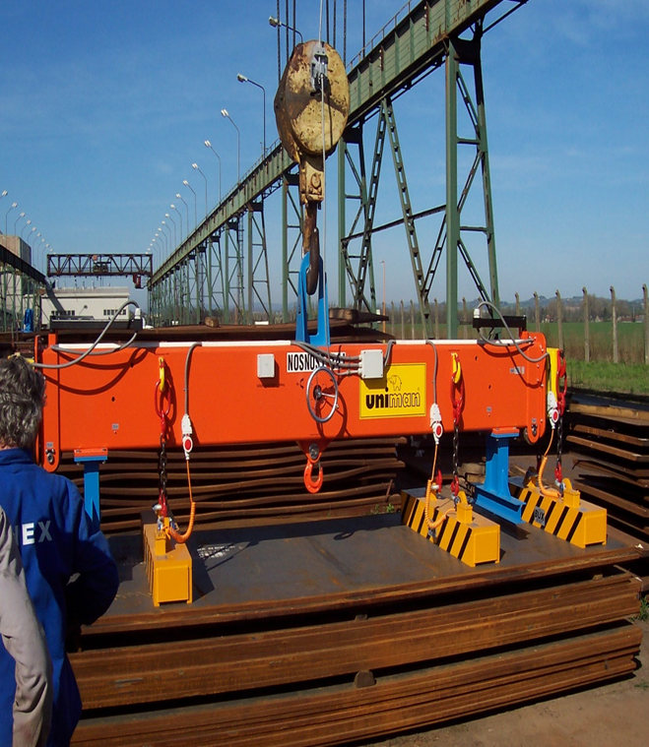
3.1
BEAMS

Slide 8
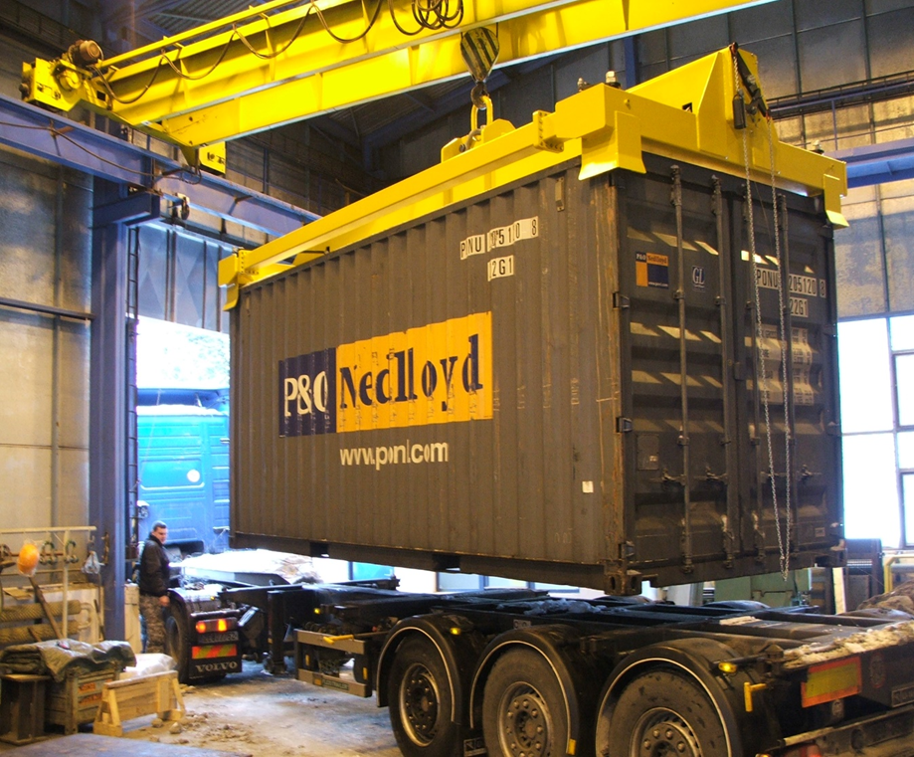
3.1.1
CONTAINER BEAMS

Slide 9
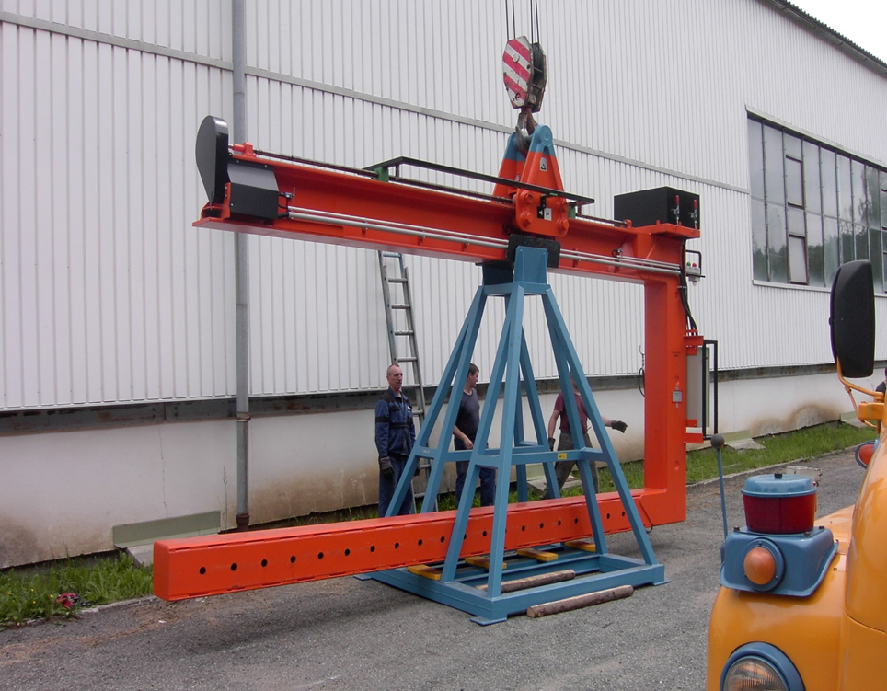
3.1.2
C-HOOKS FOR CONTAINERS

Slide 10
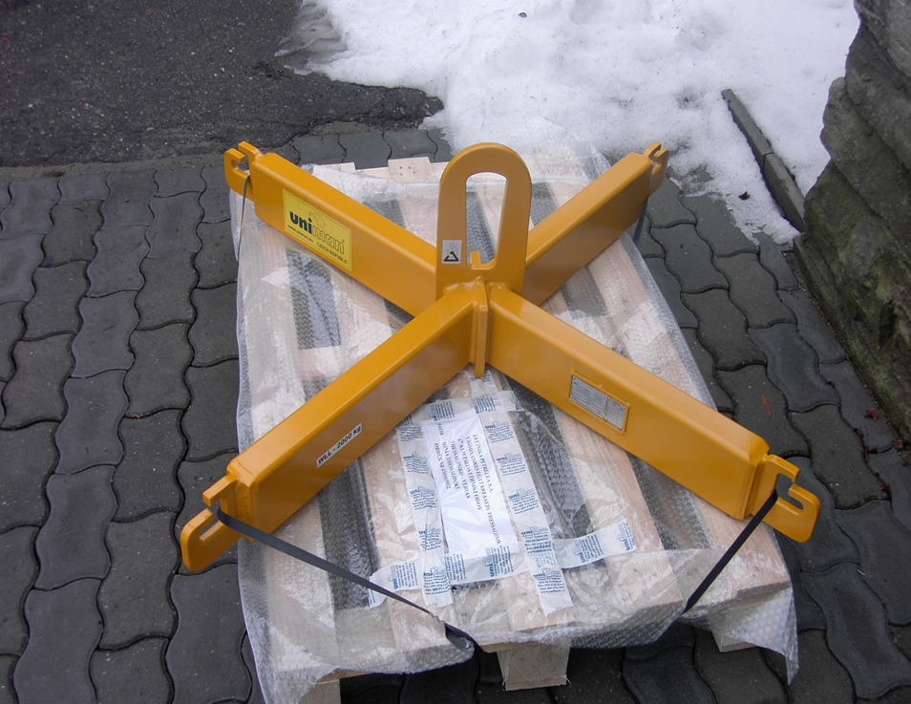
3.1.3
BIG BAG TRAVERSION

Slide 11
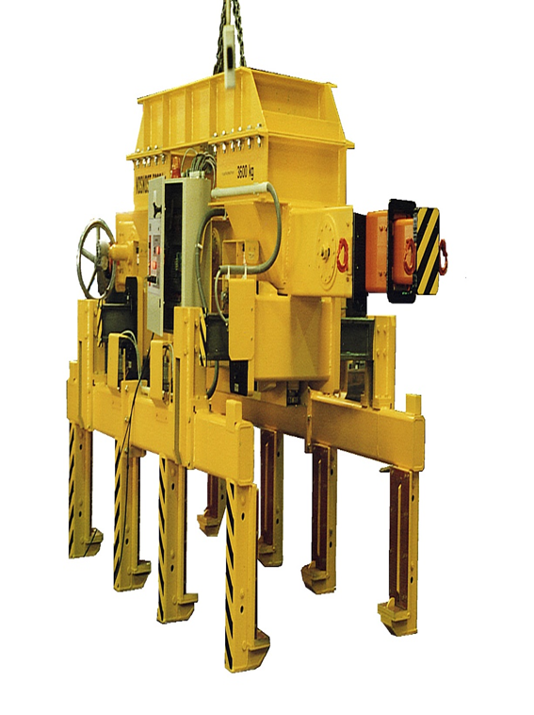
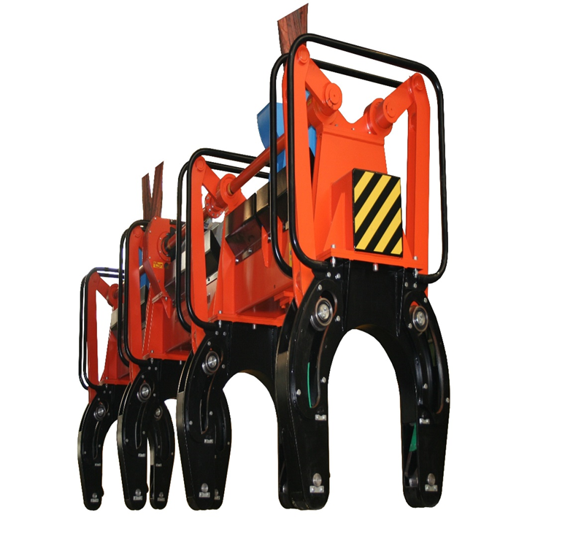
3.2
SPECIAL LIFTING GRIPPER

Slide 12
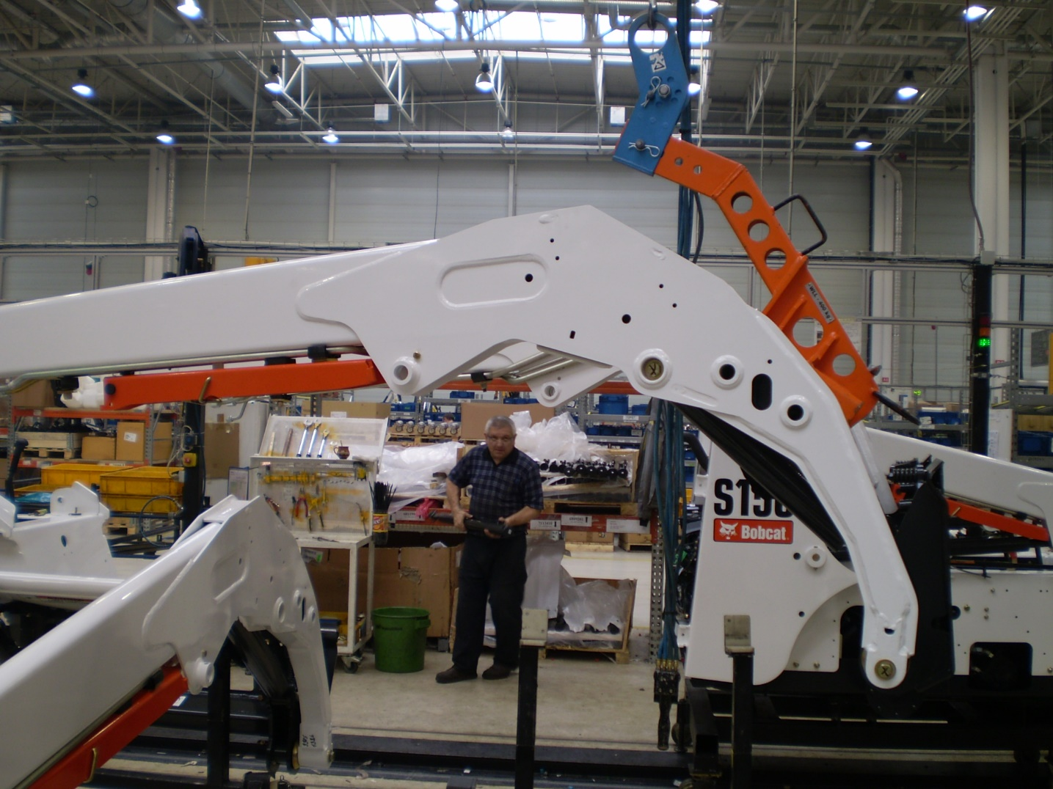
3.2
SPECIAL LIFTING GRIPPER

Slide 13
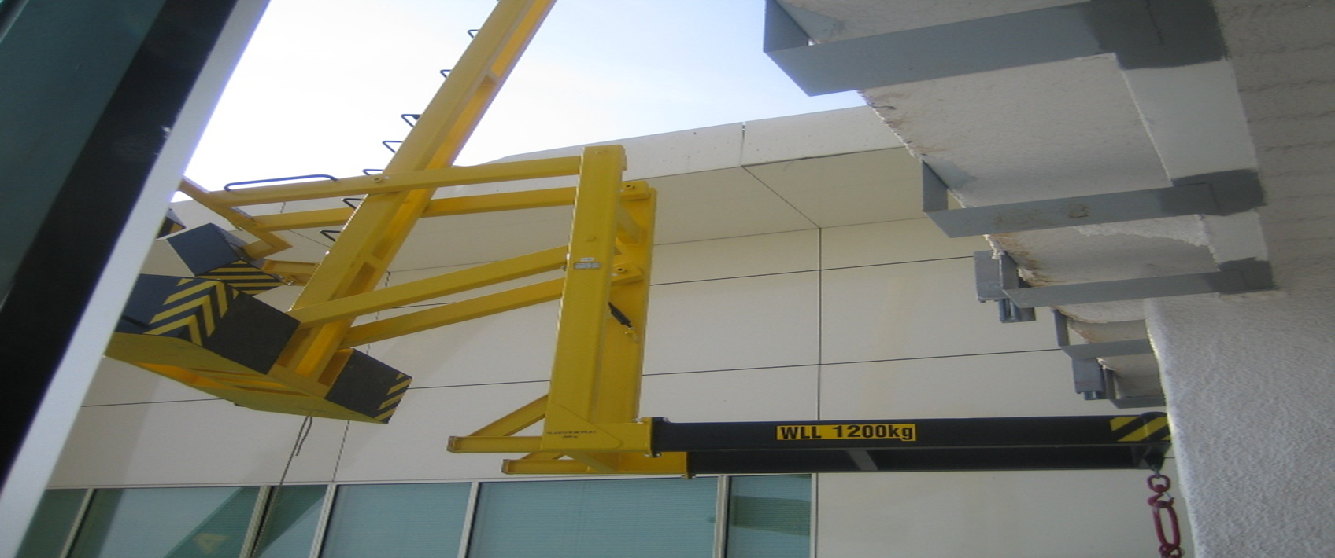
3.3
FORK HINGES ON EURO PALLETS

Slide 14
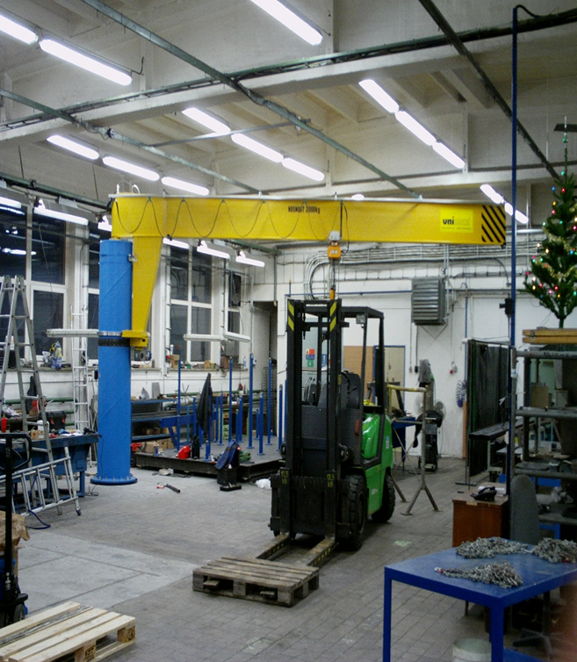
3.4
CRANES

Slide 15
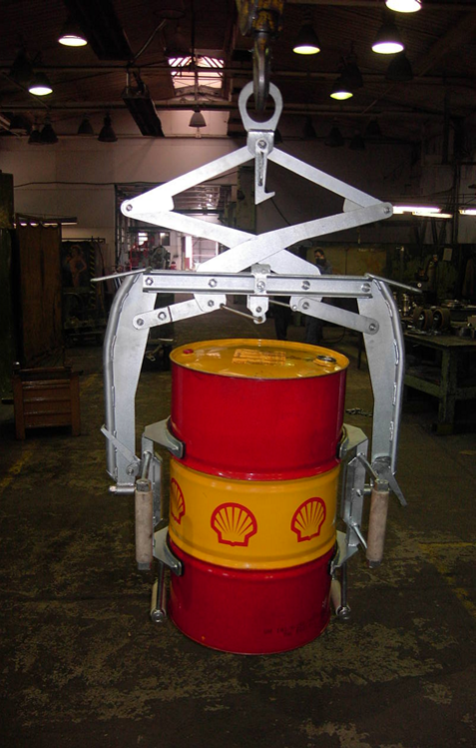
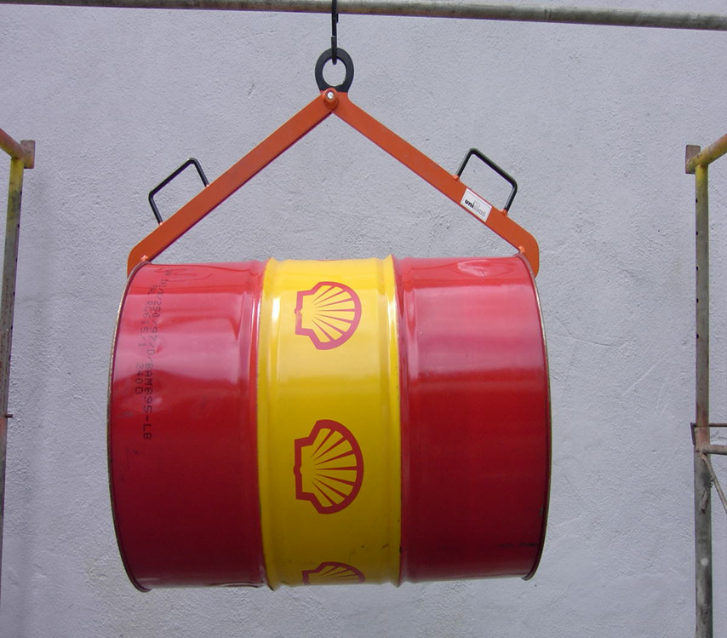
3.5
LIFTING GRIPPER FOR BARRELS

Slide 16
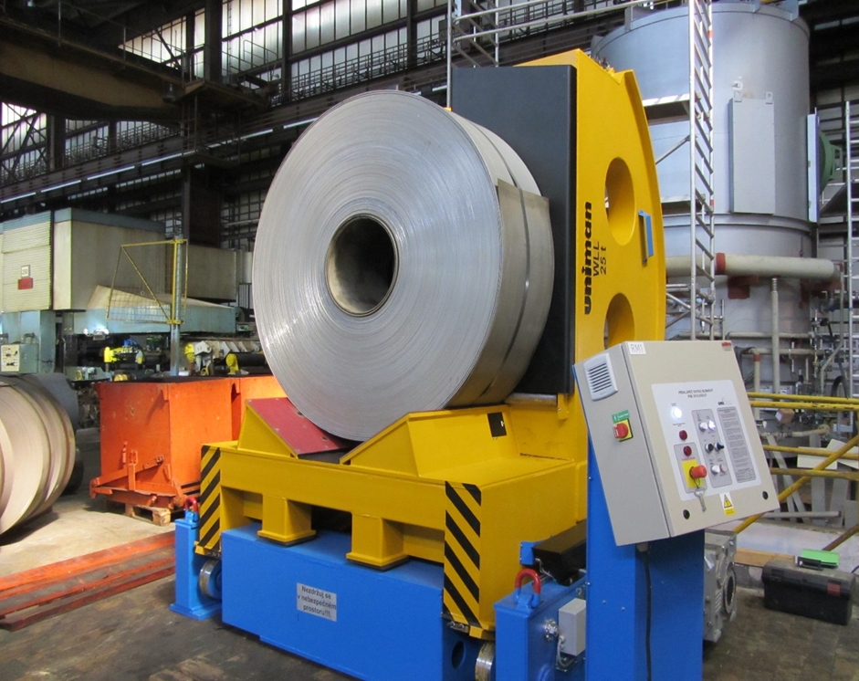
3.6
LIFTING GRIPPER FOR COIL

Slide 17
3.6.1
C-HOOKS FOR COIL

Slide 18
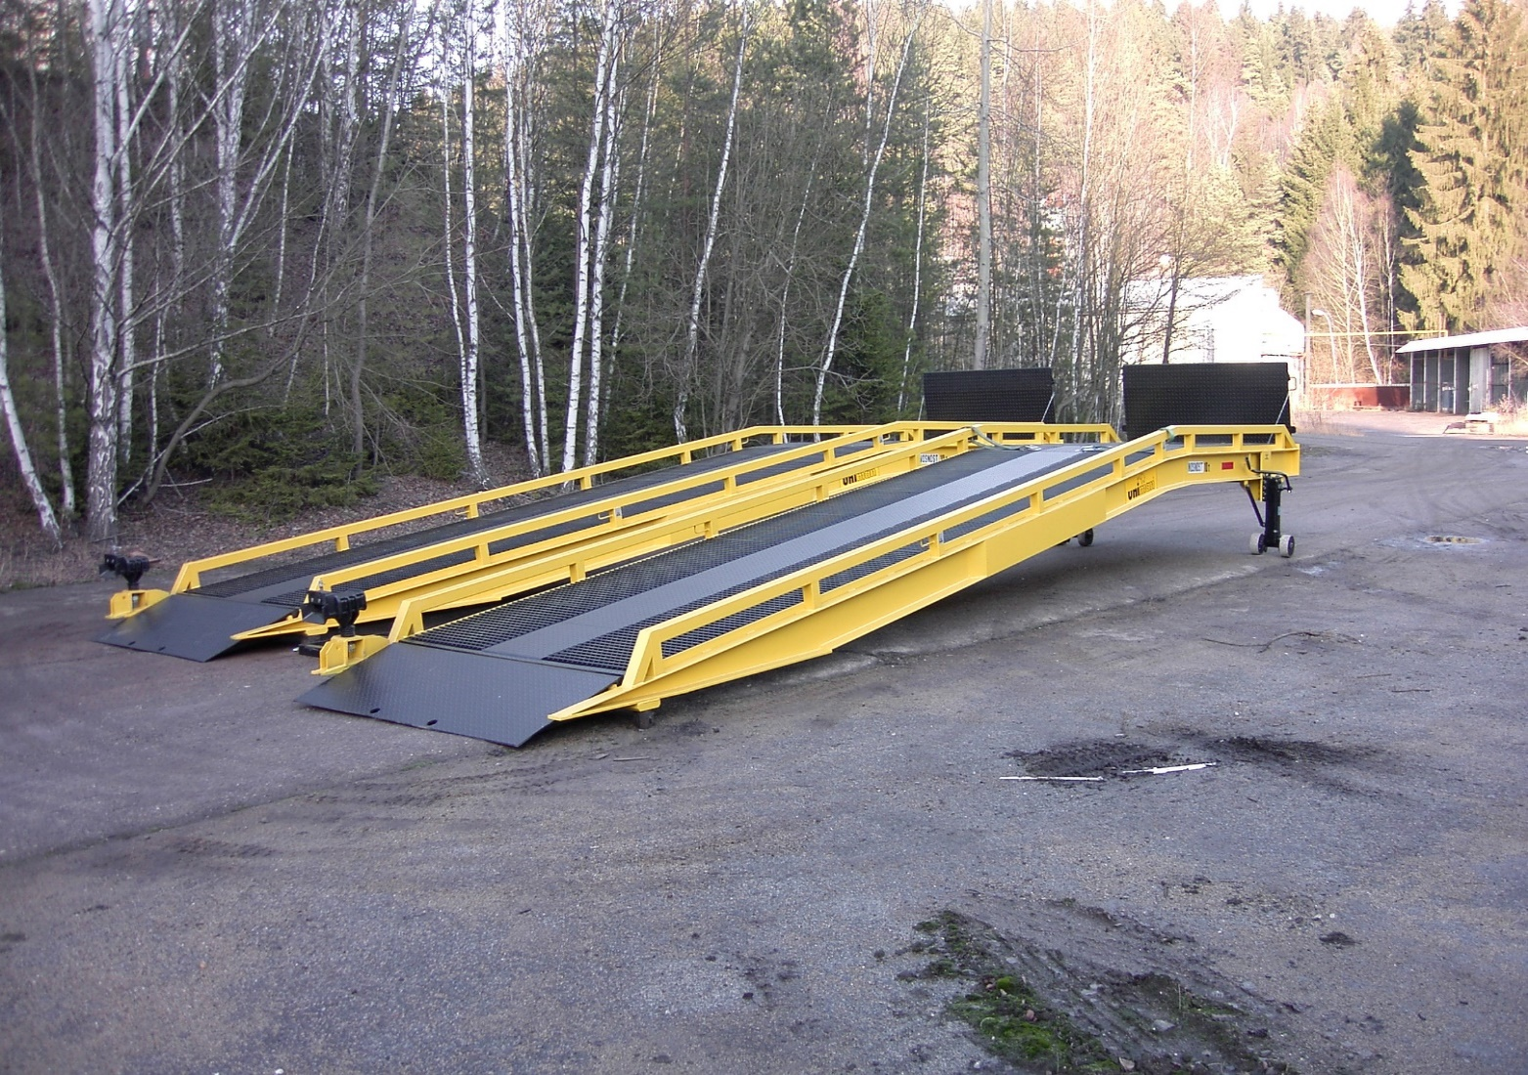
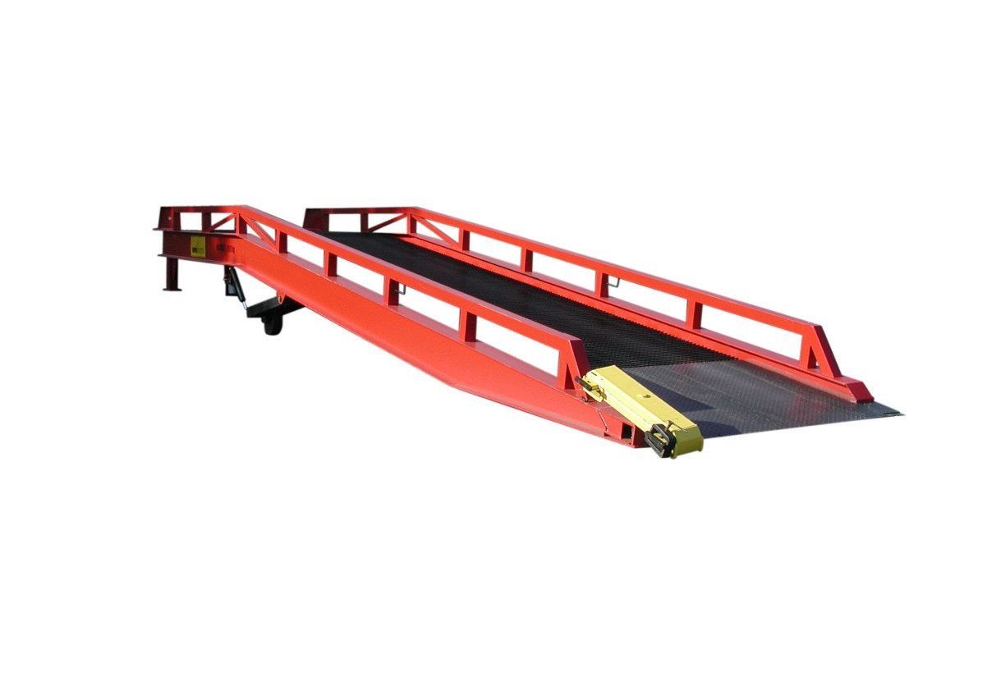
3.7
RAMPS

Slide 19
UNIMAN Englis, s.r.o.,
Velke Tresne 56, 592 65 Rovecne
WWW.UNIMAN.EU
uniman@uniman.cz
516 116 711

