Slide 1
Presentation
UNIMAN ENGLIS, s.r.o.

Slide 2
„We know to manage – to grip, to lift, to turn around, to overturn as well as to move your work.“
Company UNIMAN – there is an elephant in the logo of the company, elephant as a symbol of honour, brains and potency, and just these qualities are to characterize its potential and at the same time its product supply. Our motto says: „We know to manage – to grip, to lift, to turn around, to overturn as well as to move your work“ and the company makes this good as its own mission.

Slide 3
ABOUT UNIMAN
Company UNIMAN Englis, s.r.o. is one of the few firms in Czech Republic which is professionally engaged in handling as well as gripping engineering.
UNIMAN is specialized first and foremost in production of lifting and handling devices as well as special gripping equipment, further it isequipment for building industries, mechanical engineering, logistics and solutions for technical approach to extraordinary works in the heights. The most of deliveries represent technical solutions arising from assignments concerning load or cargo handling, the rest of our production are represented as catalogue products.
At present the company is exporting more than 80 % of its output to the countries in Europe and Asia.

Slide 4
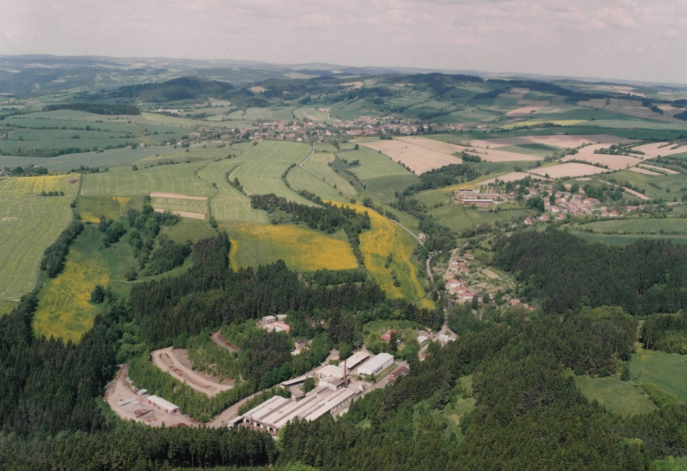
UNIMAN have residence in Velke Tresne in the district Zdar nad Sazavou in Vysocina region.
In the picture is UNIMAN facility, it consists of 4 production halls, offices and storage areas.

Slide 5
History
UNIMAN came into existence in 1995 through joining up innovative activities of Ing. Karel Englis´es design and engineering office on the one hand, and with craftsmanship and technological potency of the production base of the former enterprise SIGMA in Velké Tresné on the other hand. It was just the mergence of many years expertise in the line of lifting and handling technologies of the mentioned designing office as well as high qualified engineering production which gave rise to very interesting and competent solutions in the field of customer tailored material handling devices which are produced in compliance with user requirements resulting in most sophisticated technical level of products from design up to final assembly.

Slide 6
Product presentation
Company UNIMAN Englis, s.r.o offers products for handling practice, equipment for water treatment as well as equipment concerning technical access to customized special works. About 30% of production are customized solutions produced in accordance to assignment and the rest pose catalogue deliveries as well as production of engineering products made in agreement with custom documentation
All products in current offer have originally been customized piece-works, and therefore the entire present supply is represented by technical equipments which are proved in practice, they are tried-and-tested and all of them with references.
The following presentation offers the firm products representing the line of handling and gripping devices.

Slide 7
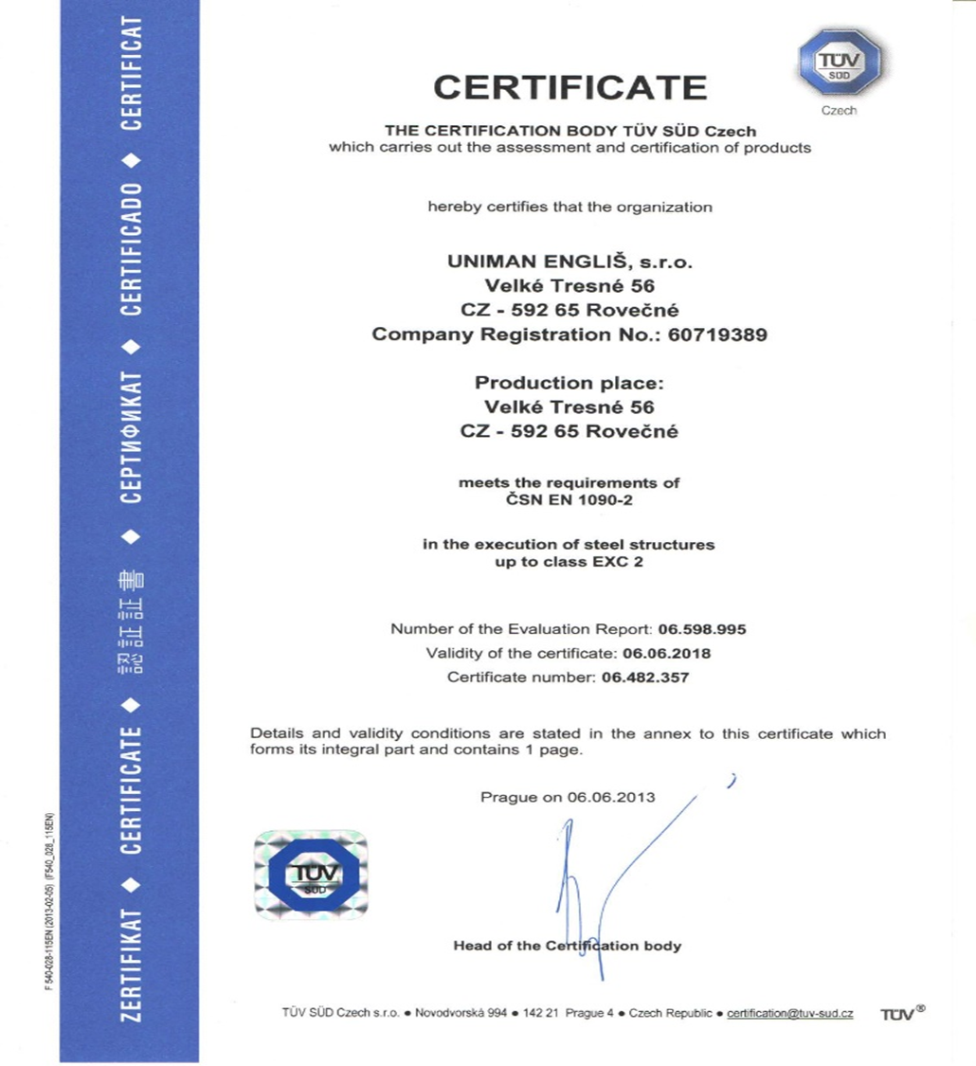
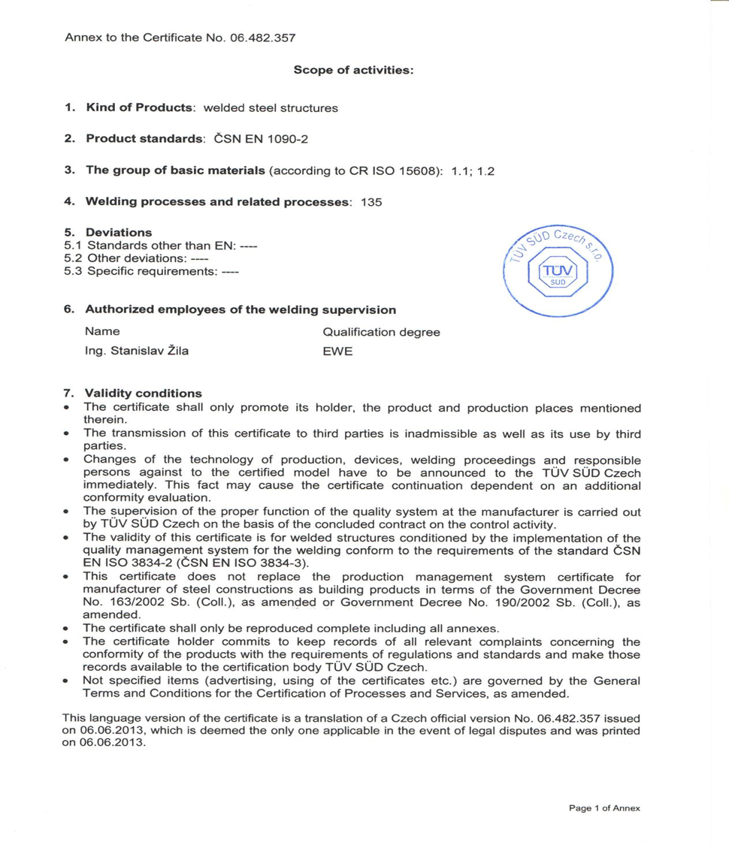
CERTIFICATE

Slide 8
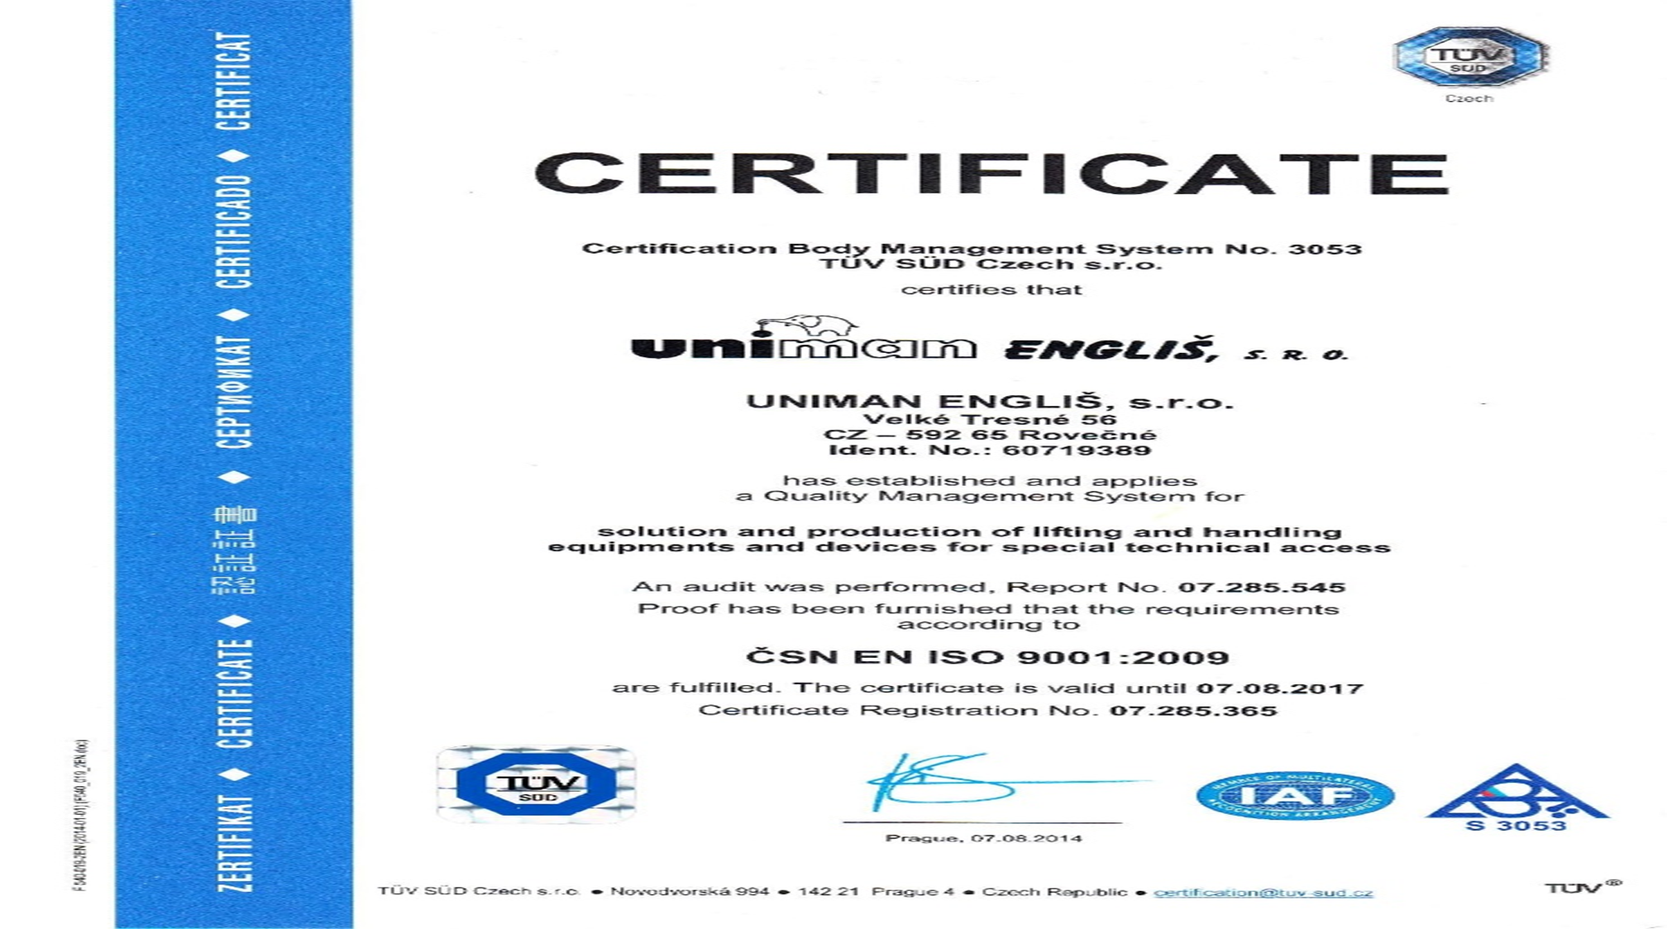

Slide 9
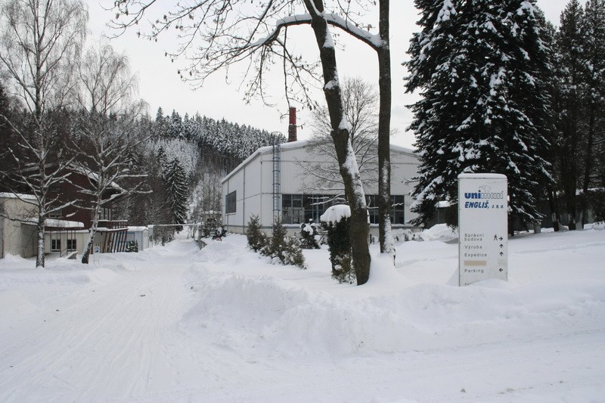
PRODUCTS
BEAMS
SPECIAL LIFTING GRIPPER
FORK HINGES ON EURO PALLETS
CRANES
LIFTING GRIPPER FOR CYLINDERS
LIFTING GRIPPER FOR BARRELS
LIFTING GRIPPER FOR COIL
RAMPS
RAIL GRIPPER
service platforms to fork anD ACCESS BASKETS

Slide 10
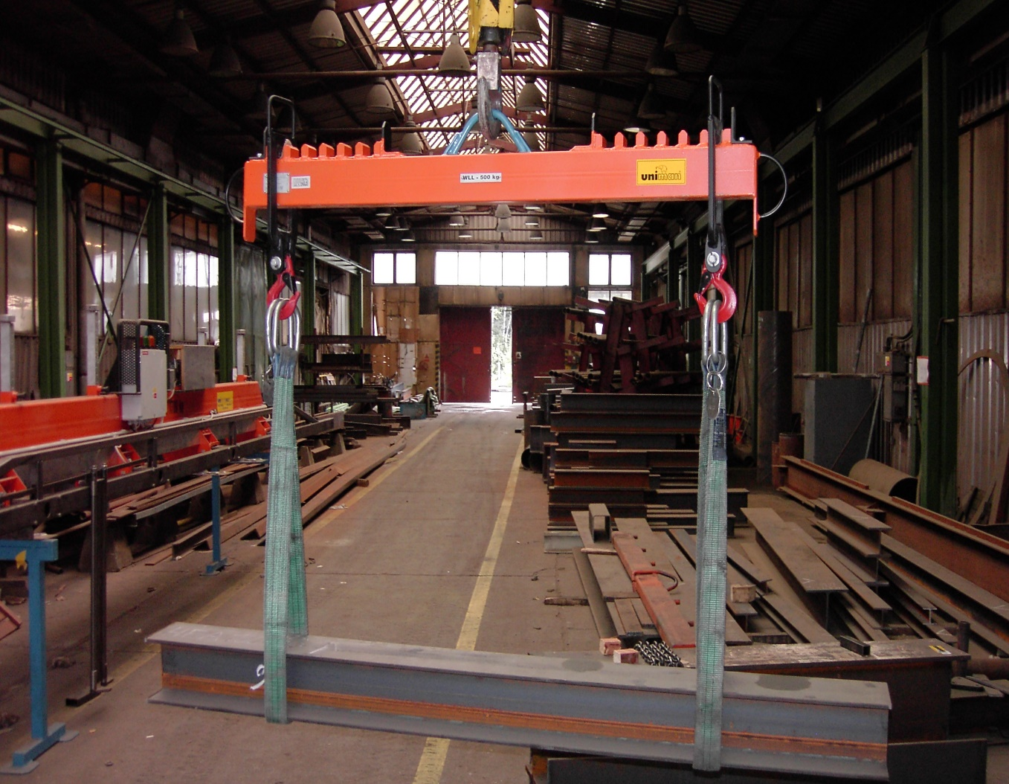
BEAMS

Slide 11
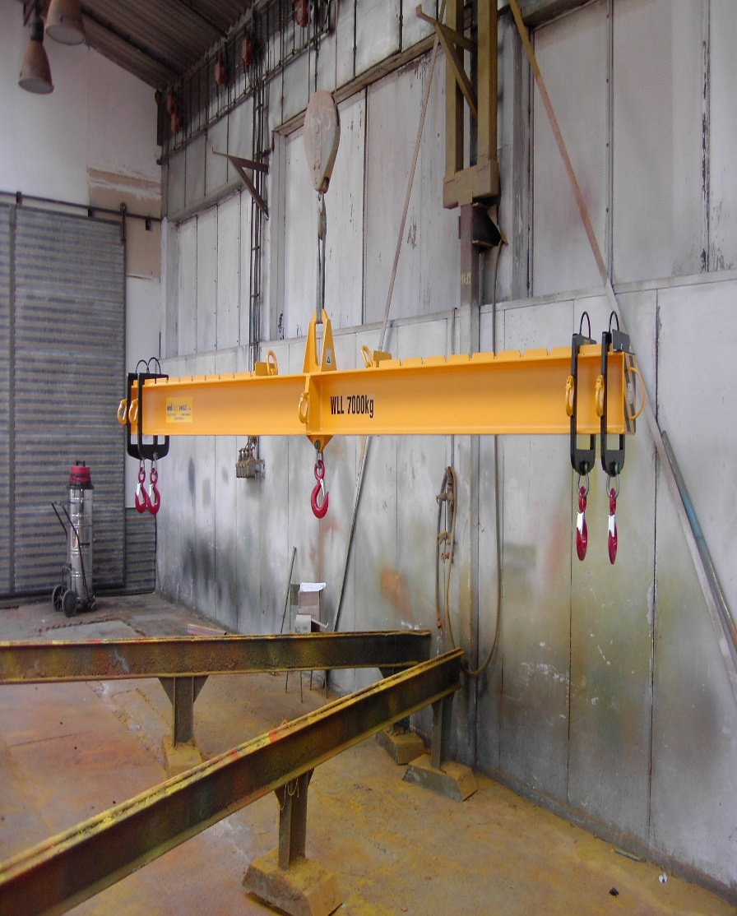
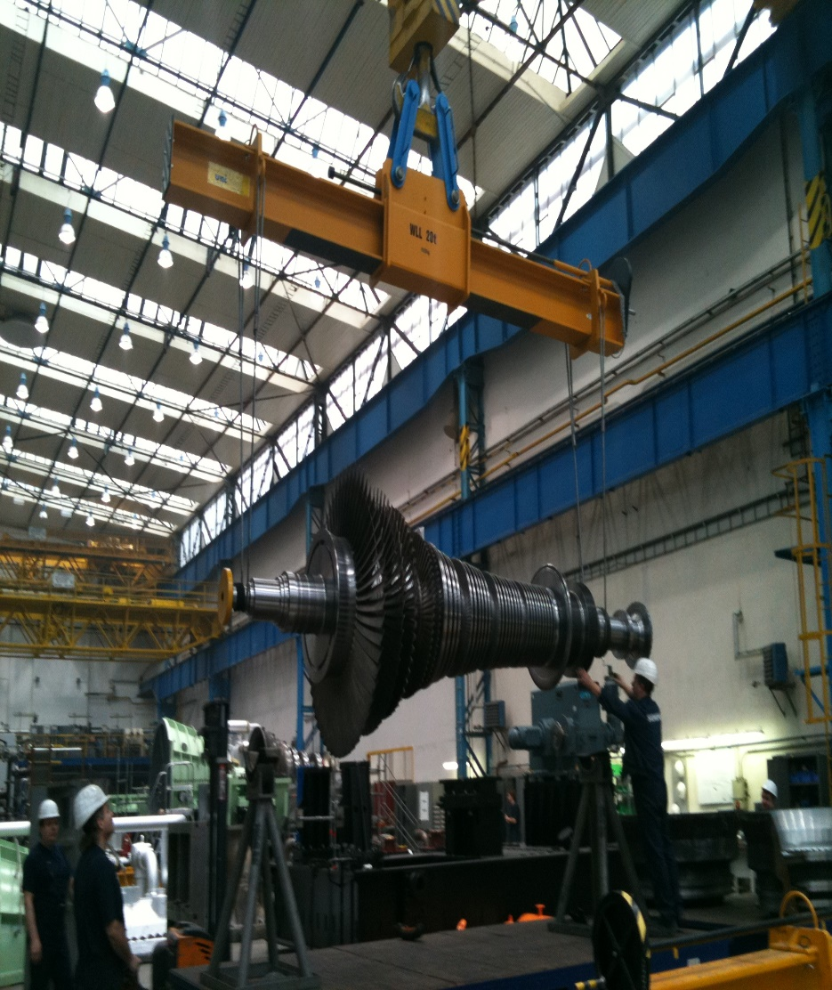
BEAMS

Slide 12
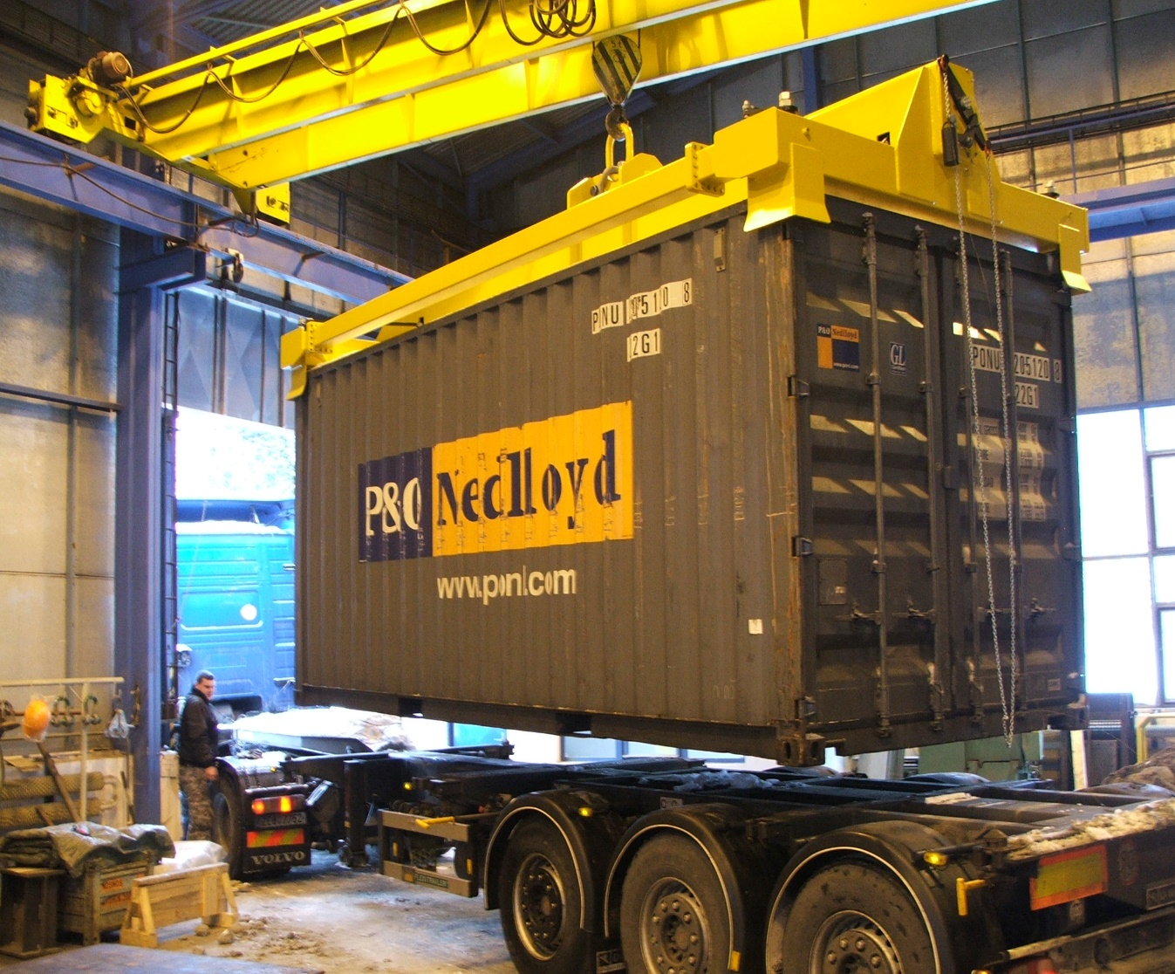
BEAMS
CONTAINER BEAMS

Slide 13
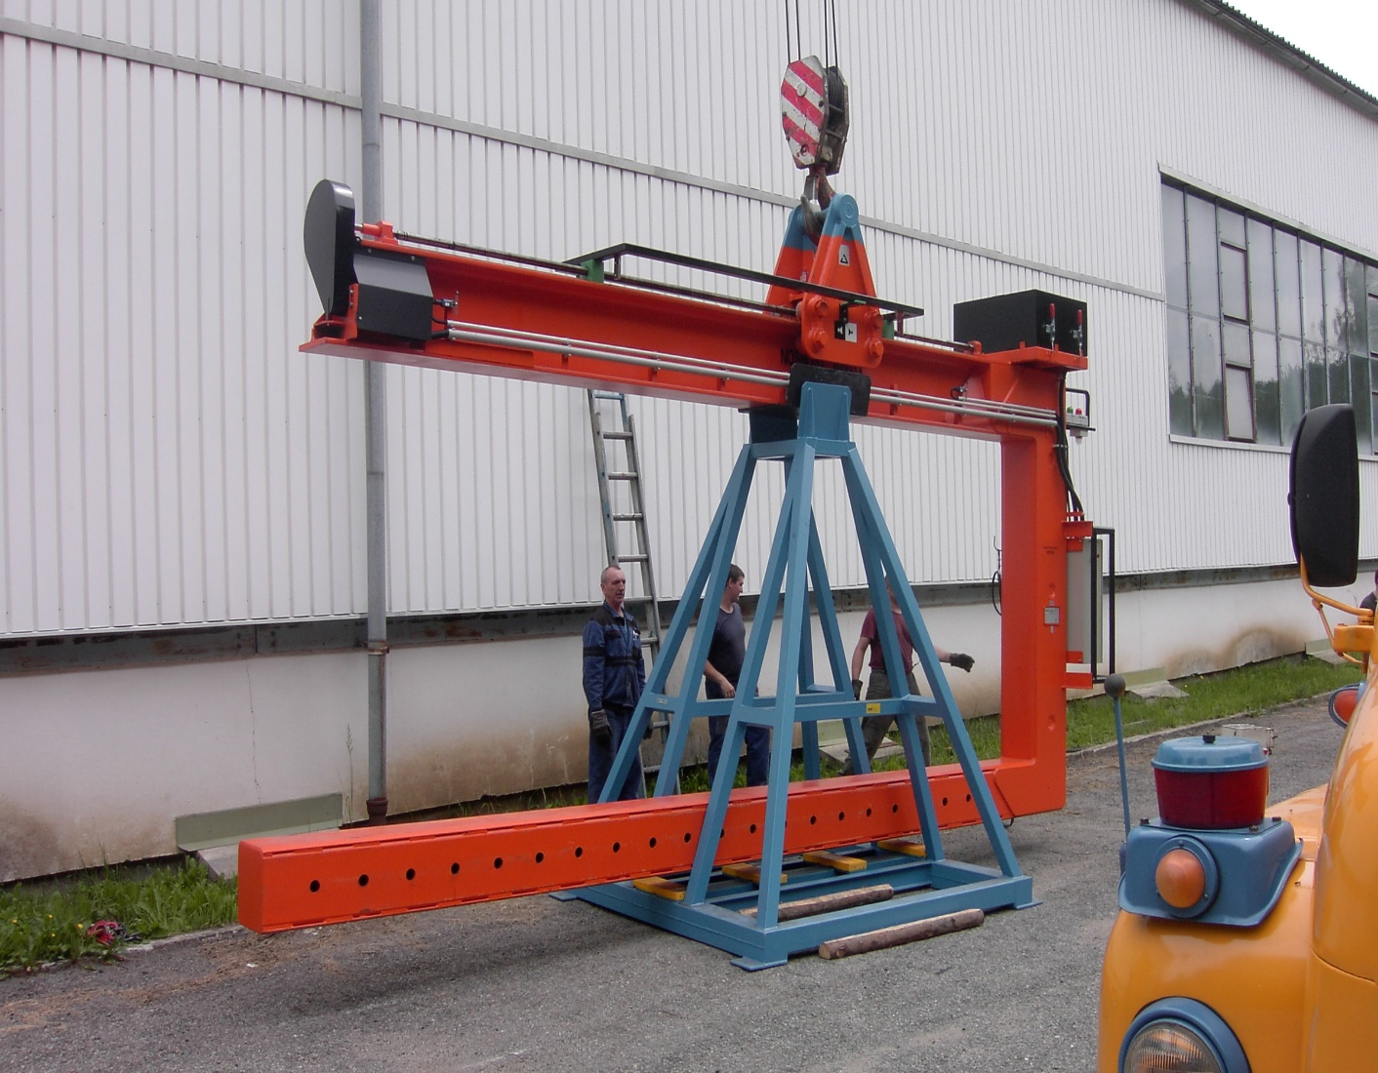
BEAMS
C-HOOKS FOR CONTAINERS

Slide 14
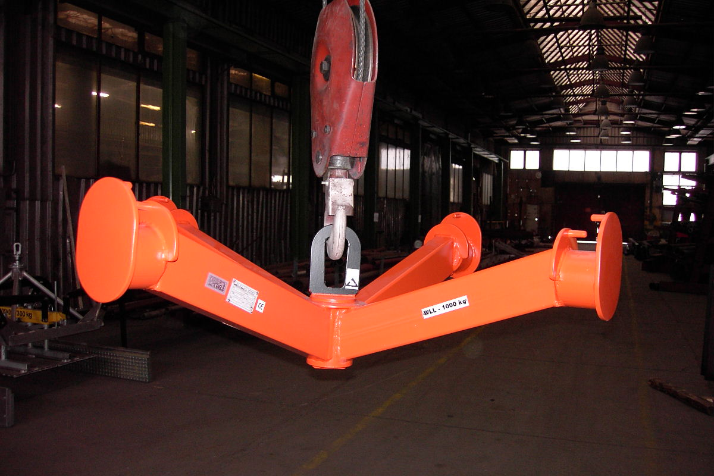
BEAMS
BIG BAG TRAVERSION

Slide 15
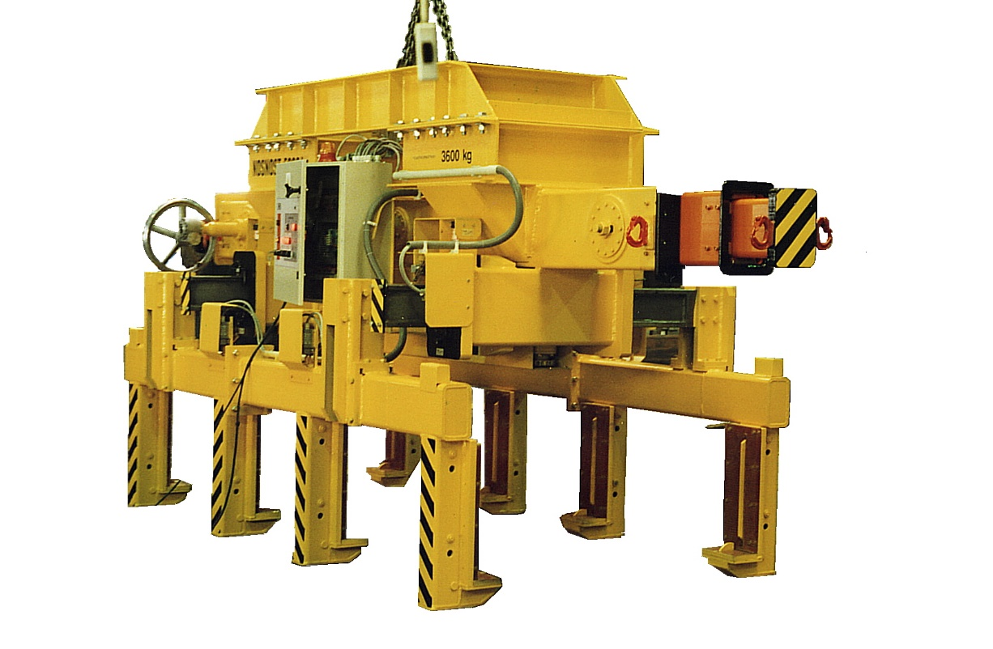
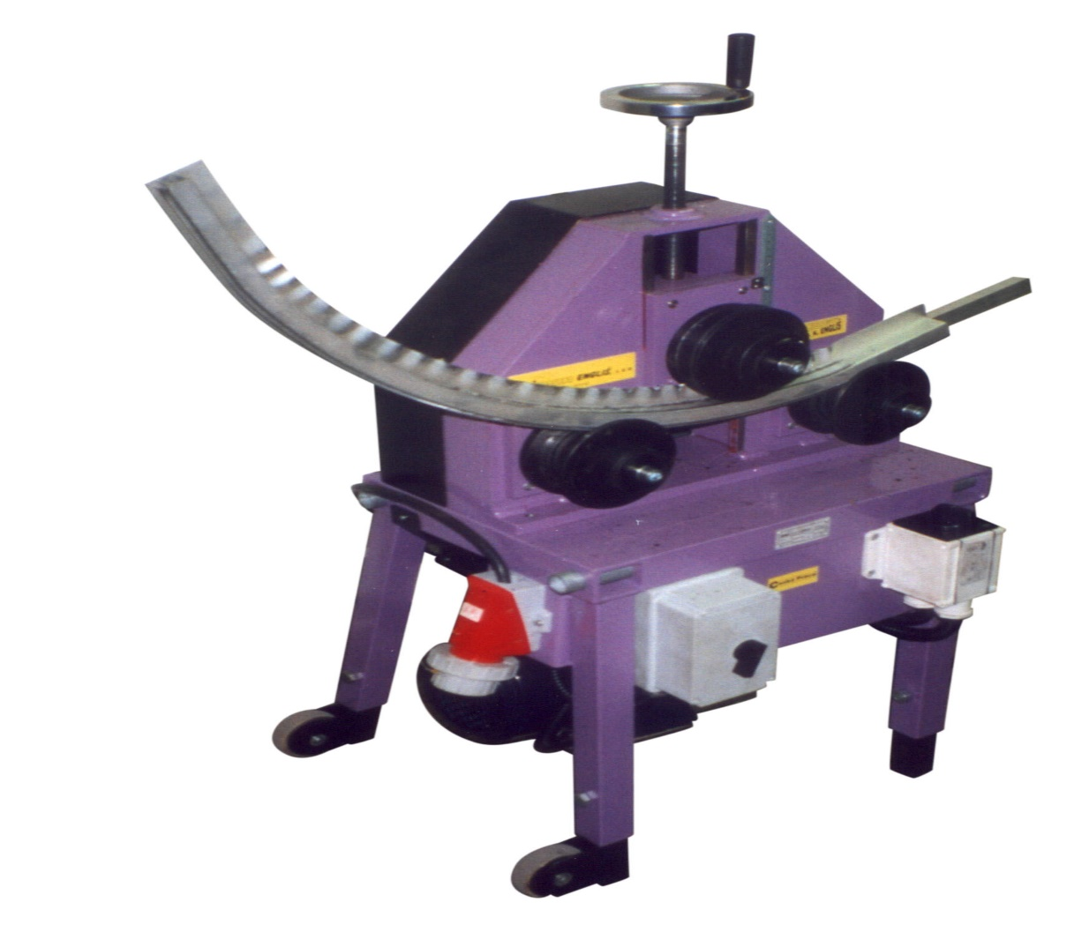
SPECIAL LIFTING GRIPPER

Slide 16
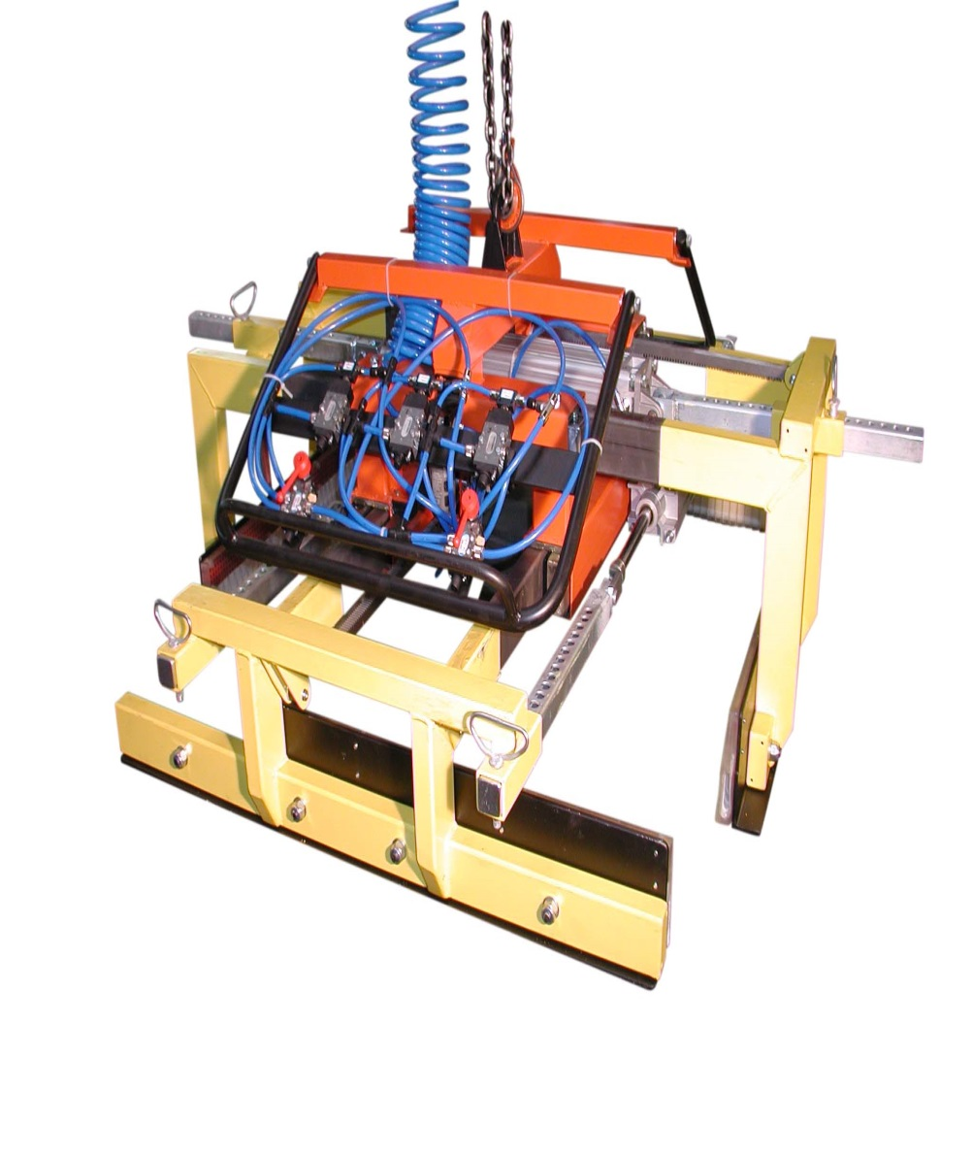
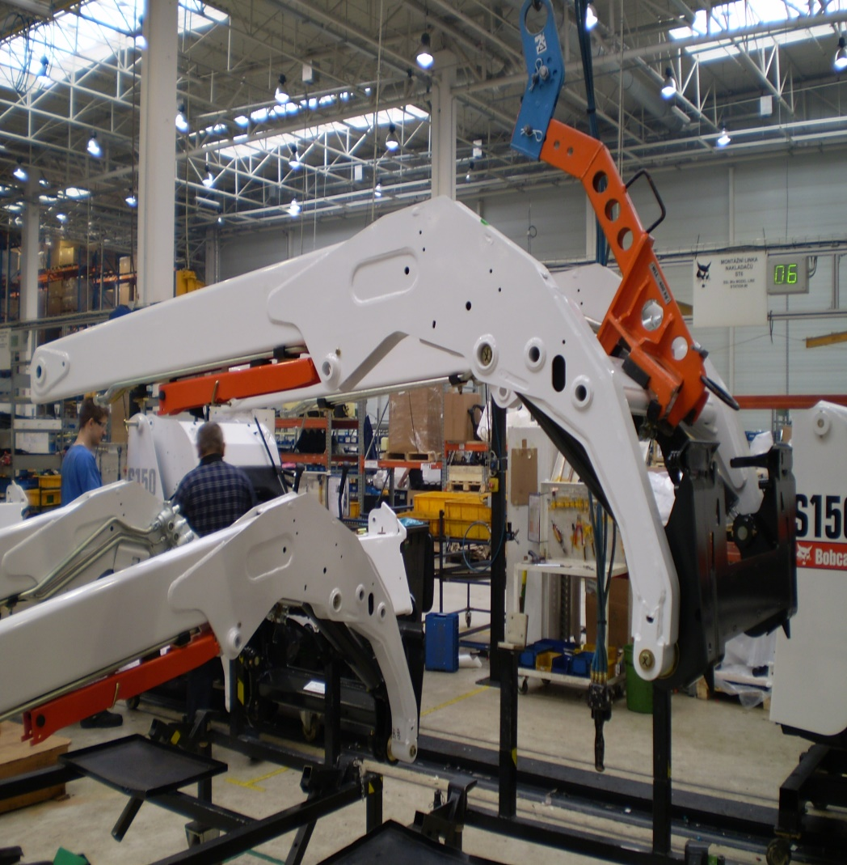
SPECIAL LIFTING GRIPPER

Slide 17
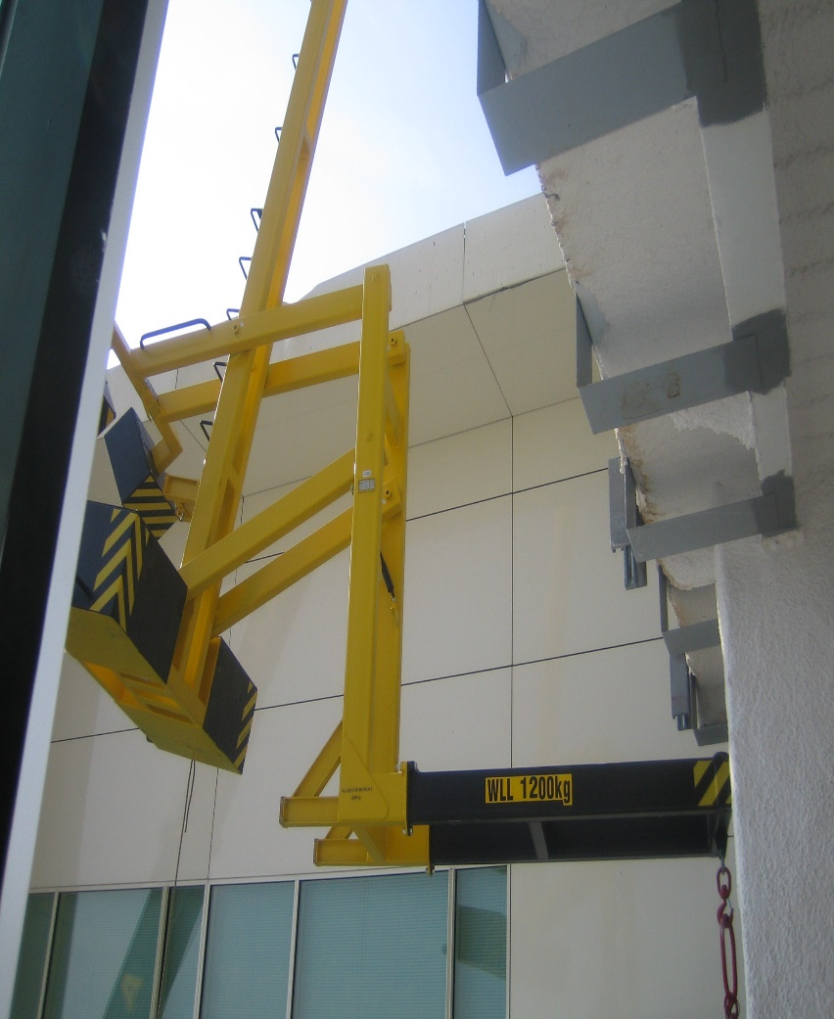
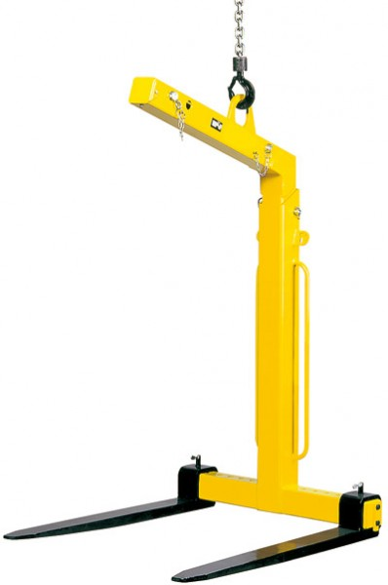
FORK HINGES ON EURO PALLETS

Slide 18
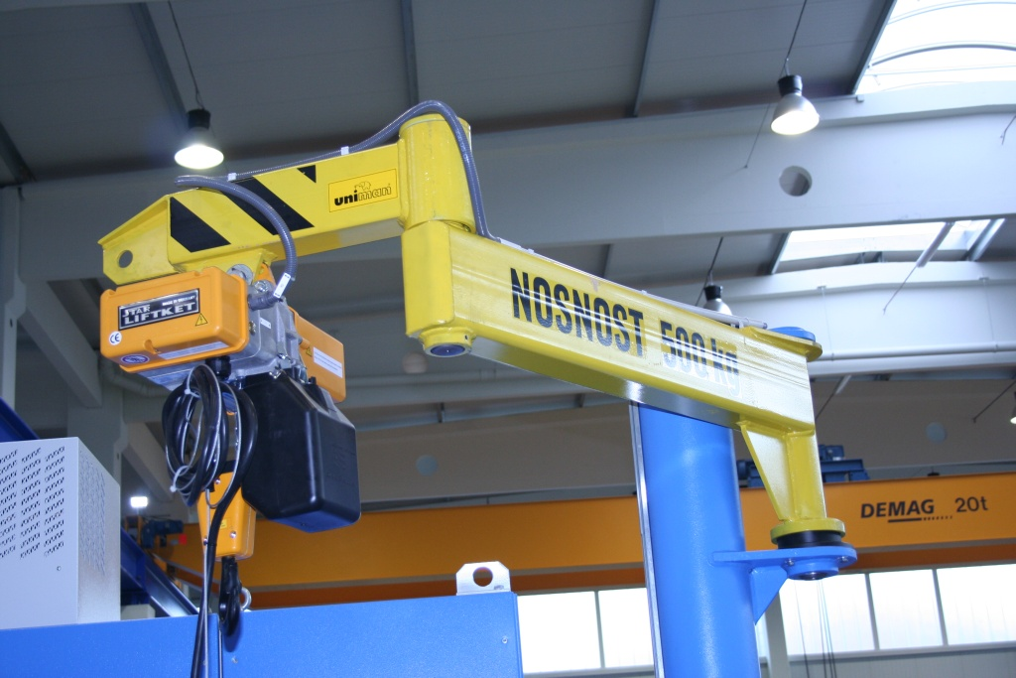
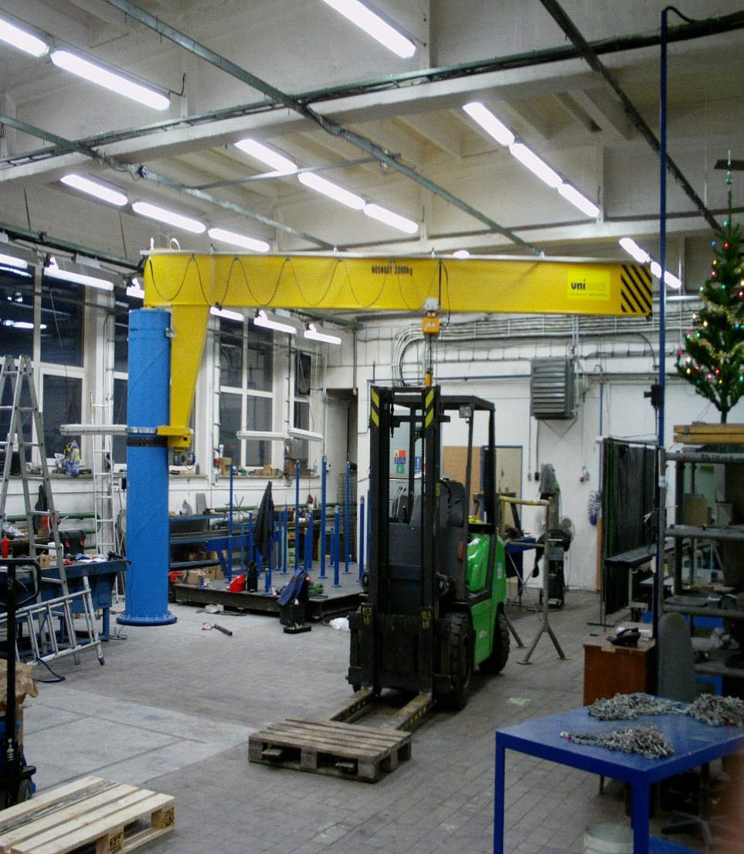
CRANES
DERRICKS

Slide 19
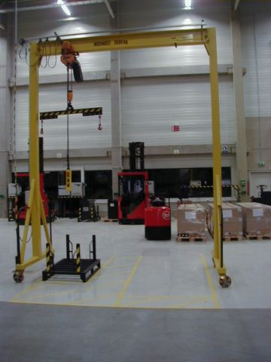
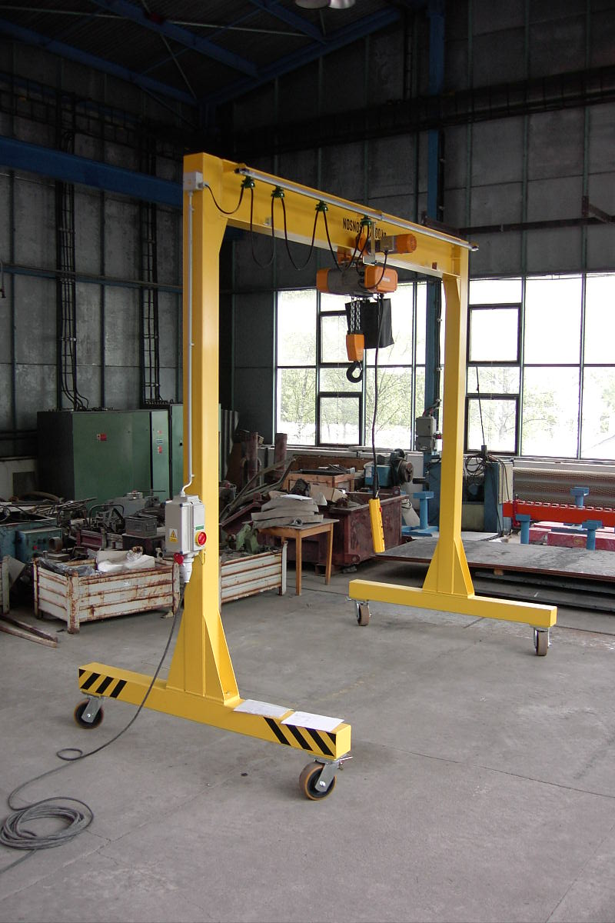
CRANES
GANTRY CRANES

Slide 20
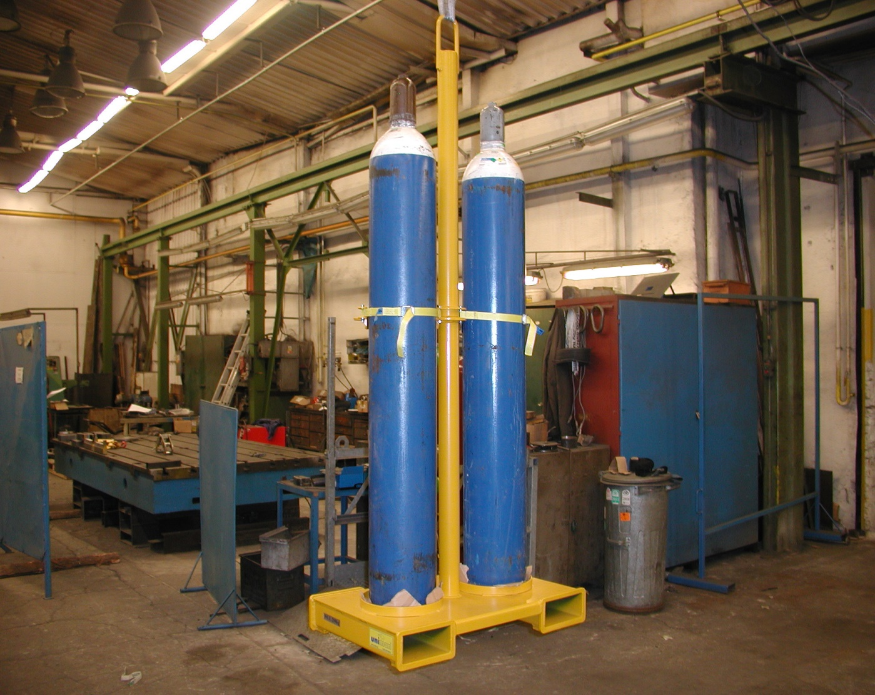
LIFTING GRIPPER FOR CYLINDERS

Slide 21
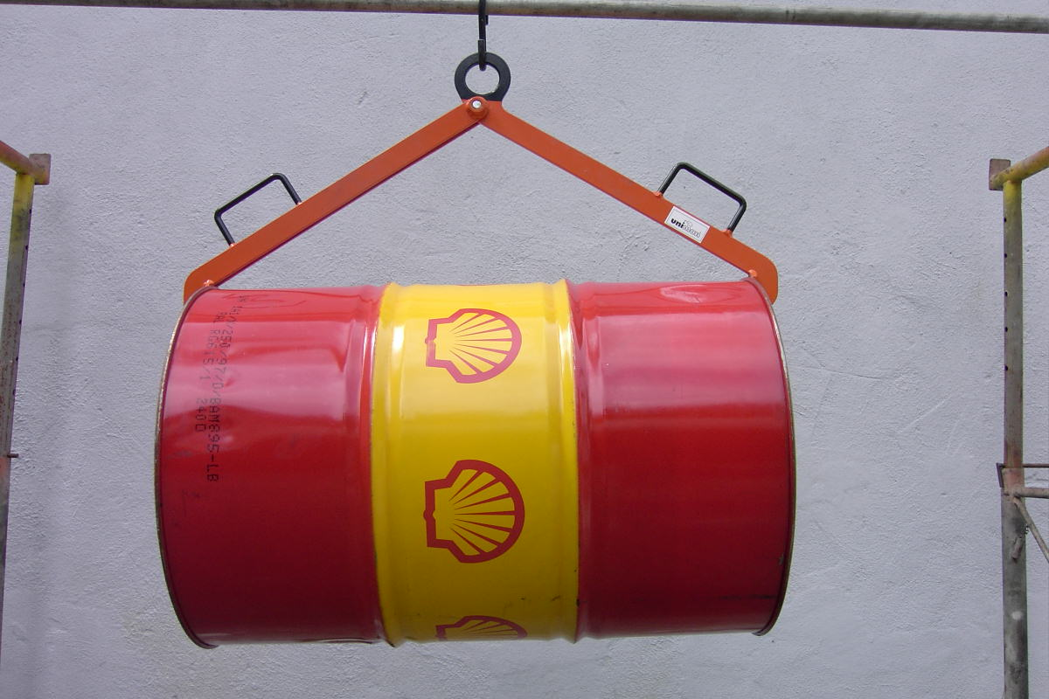
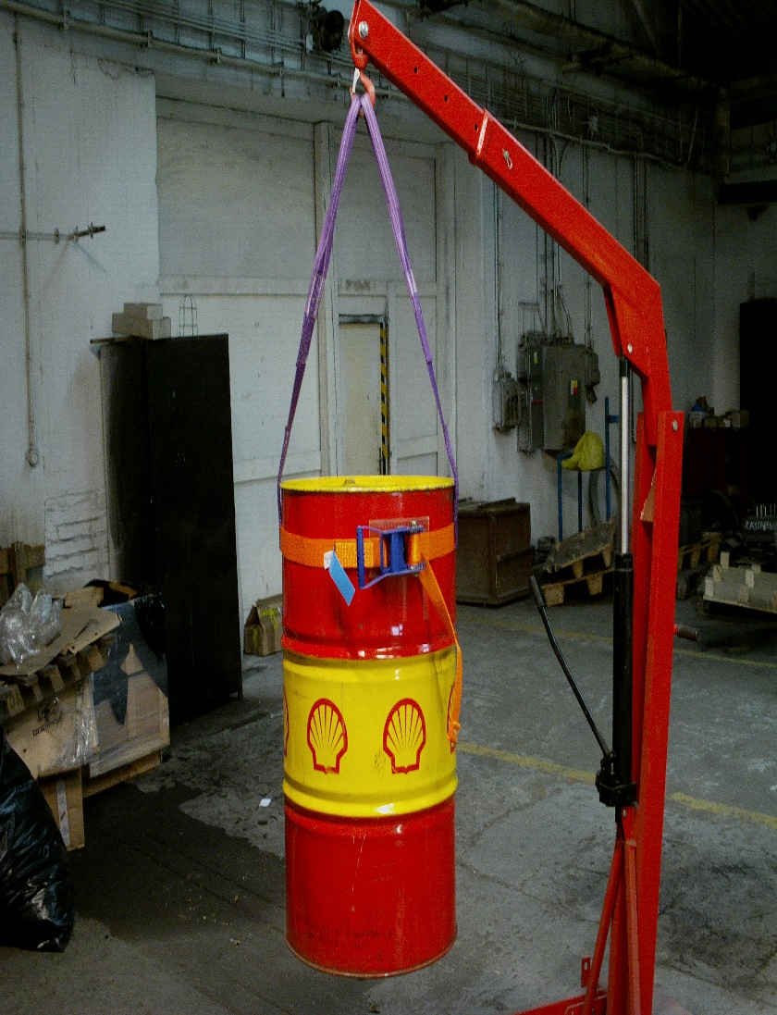
LIFTING GRIPPER FOR BARRELS

Slide 22
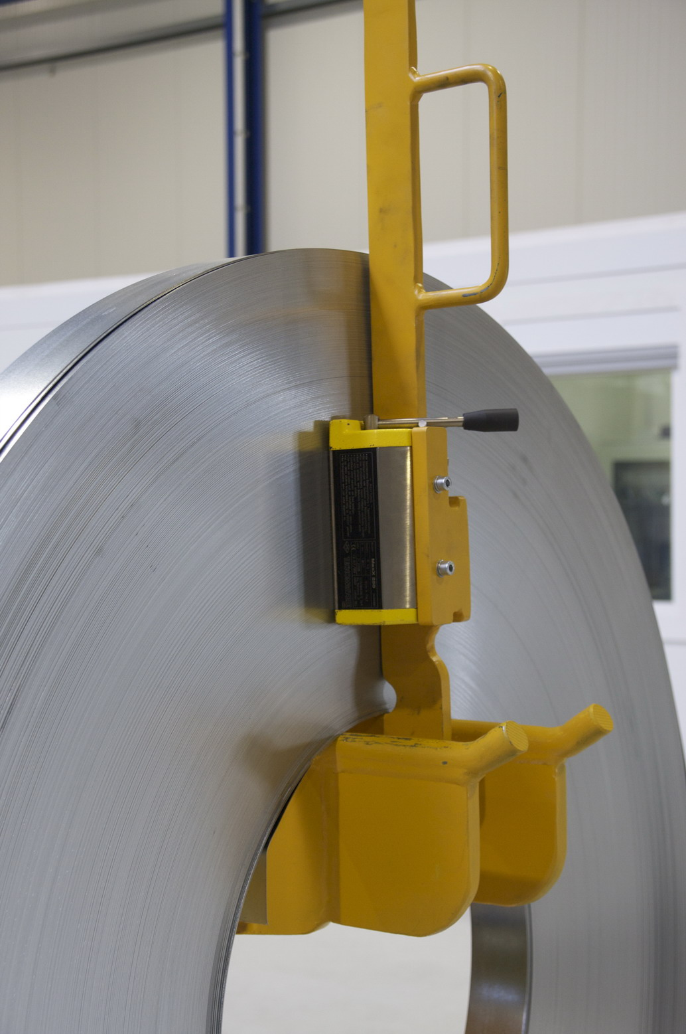
LIFTING GRIPPER FOR COIL

Slide 23
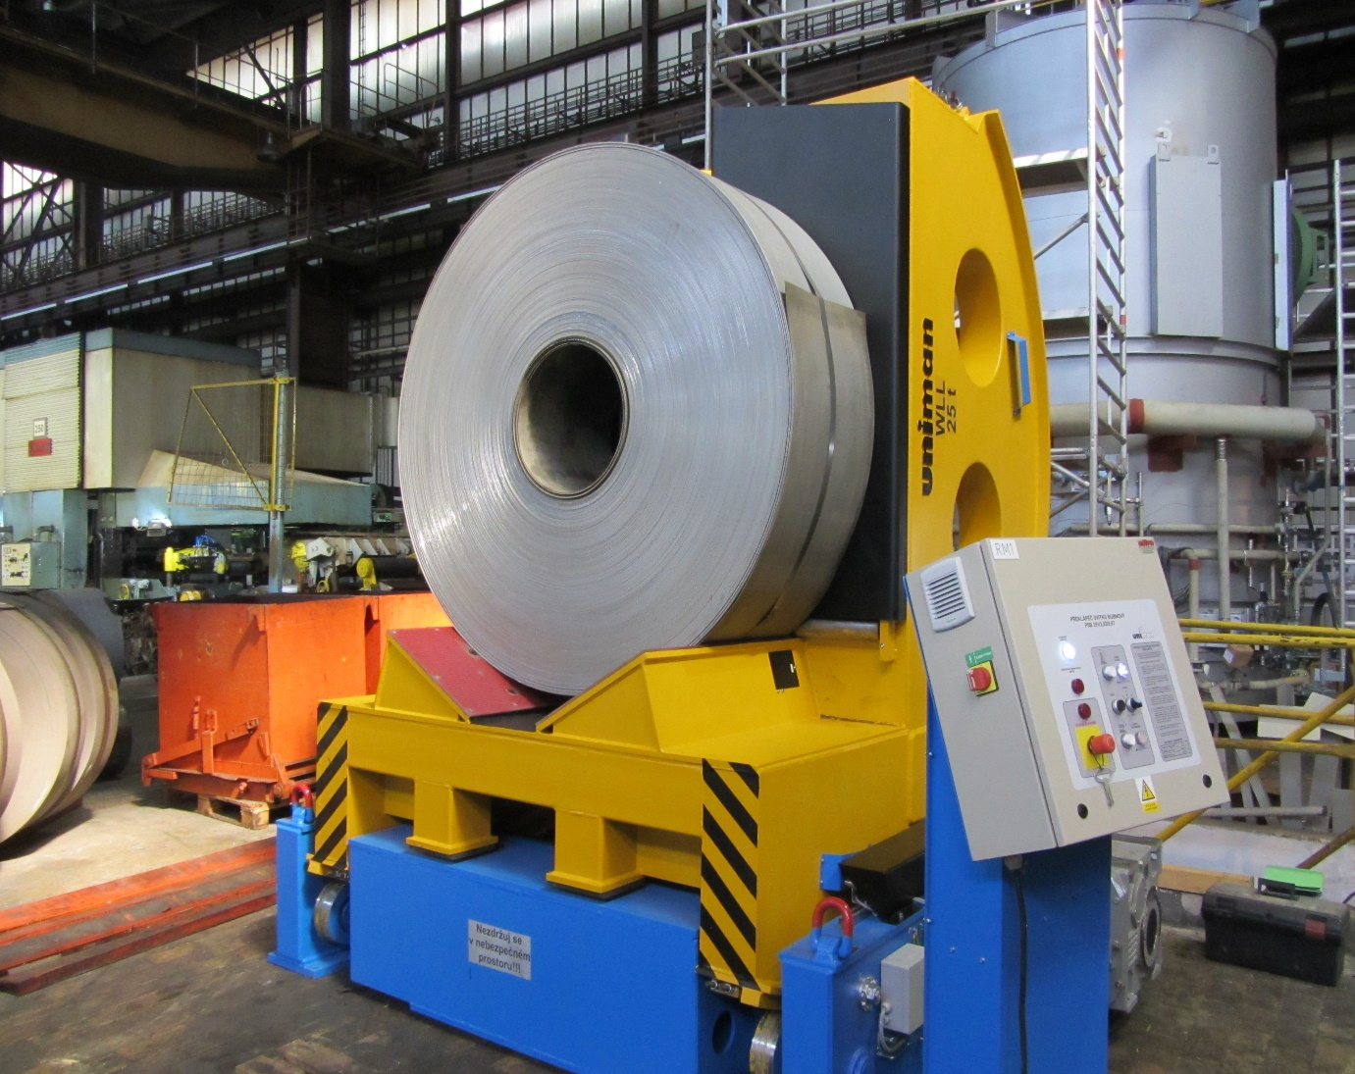
LIFTING GRIPPER FOR COIL
TILT

Slide 24
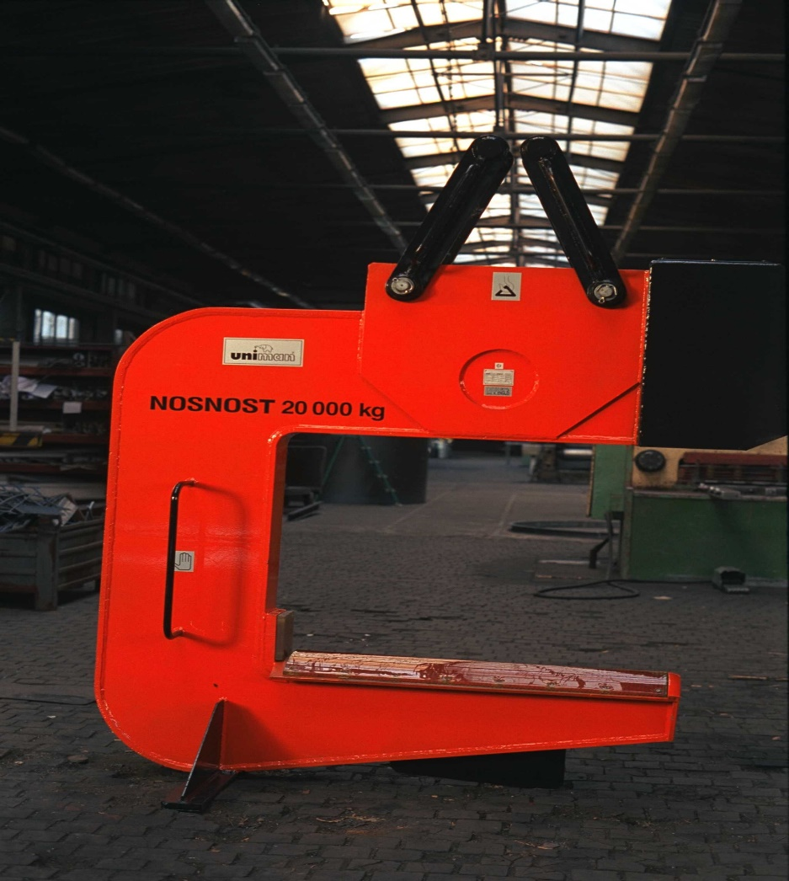
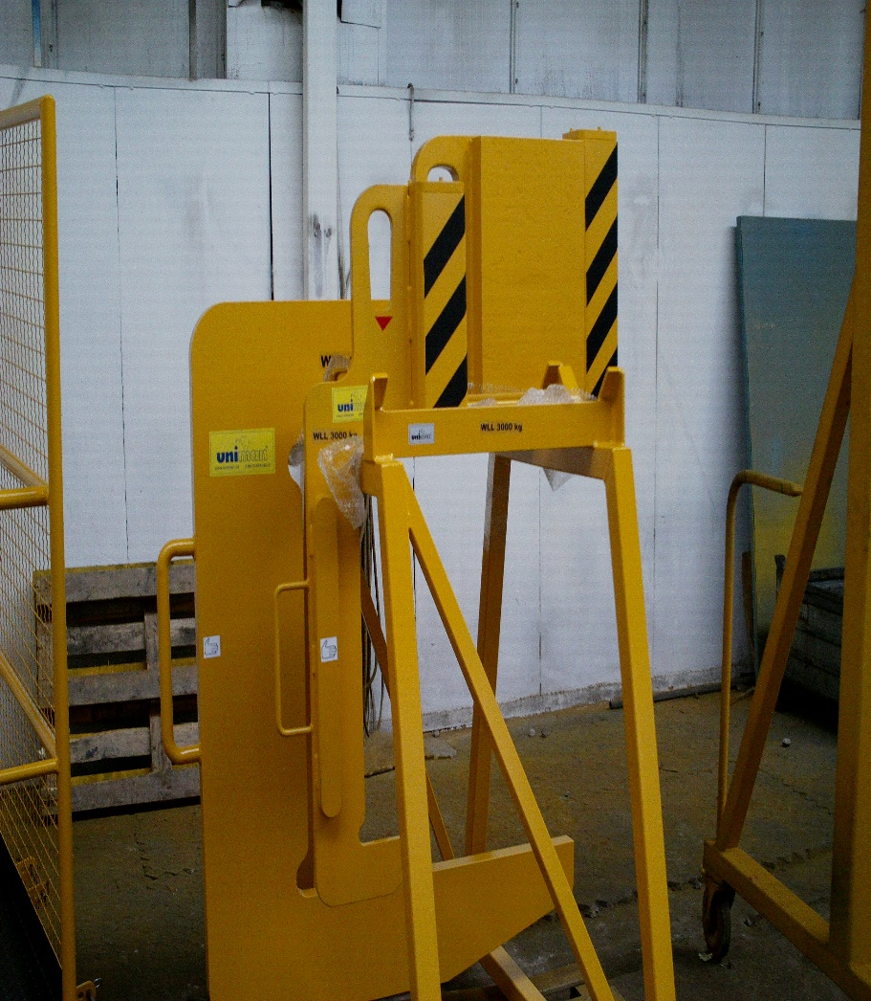
LIFTING GRIPPER FOR COIL
C-HOOKS
C-HOOK WITH SECUTEX PROTECTION
CLASSIC C-HOOK
SPECIAL C-HOOK

Slide 25
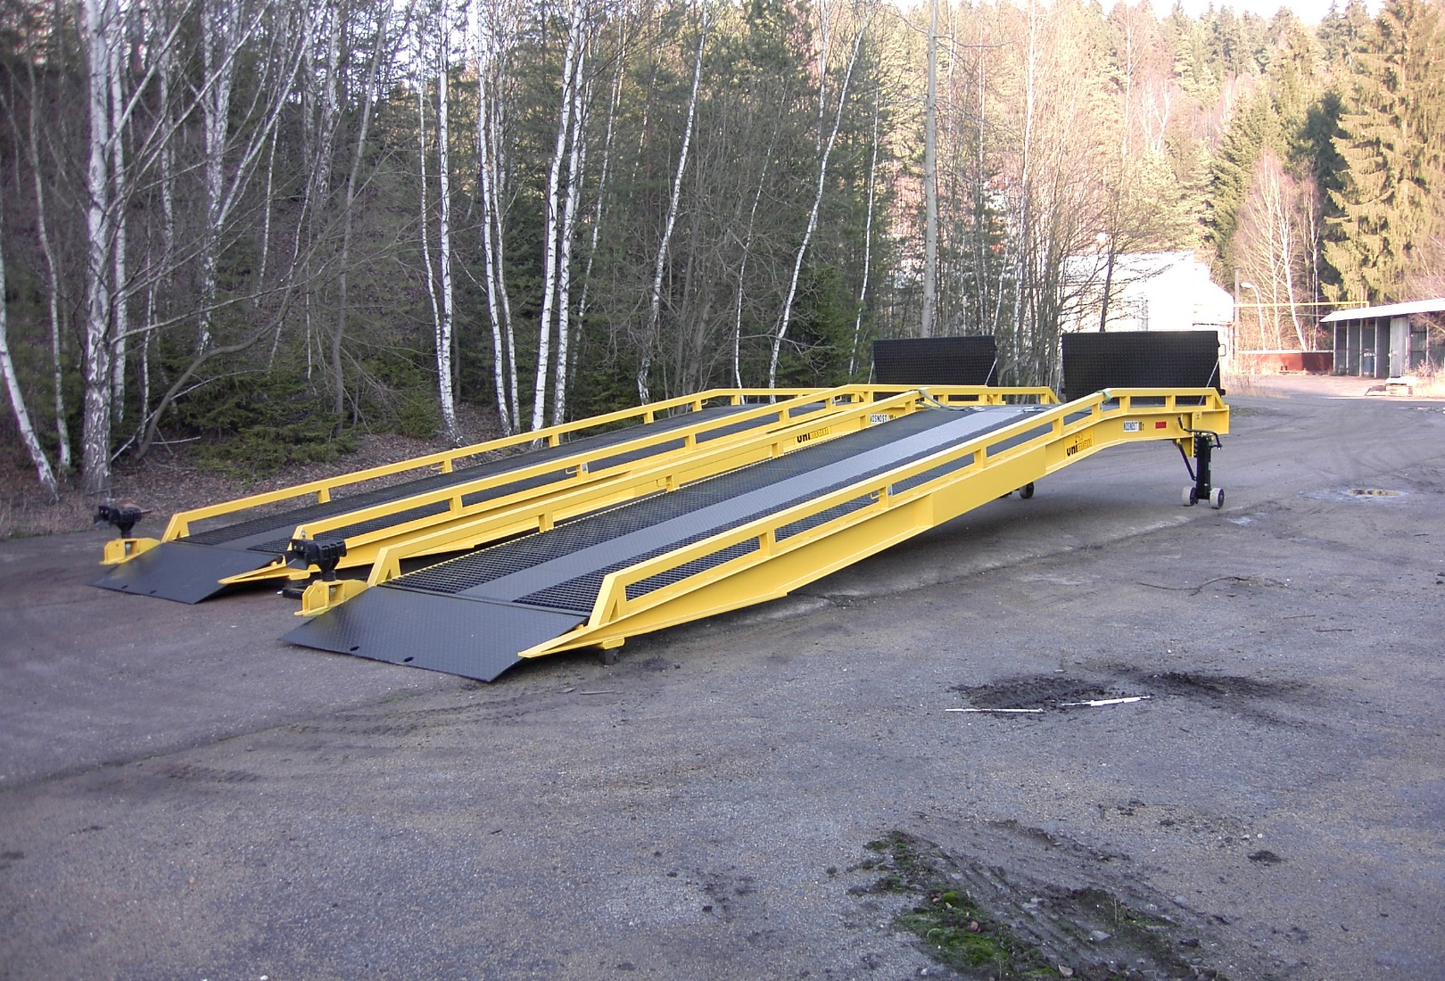
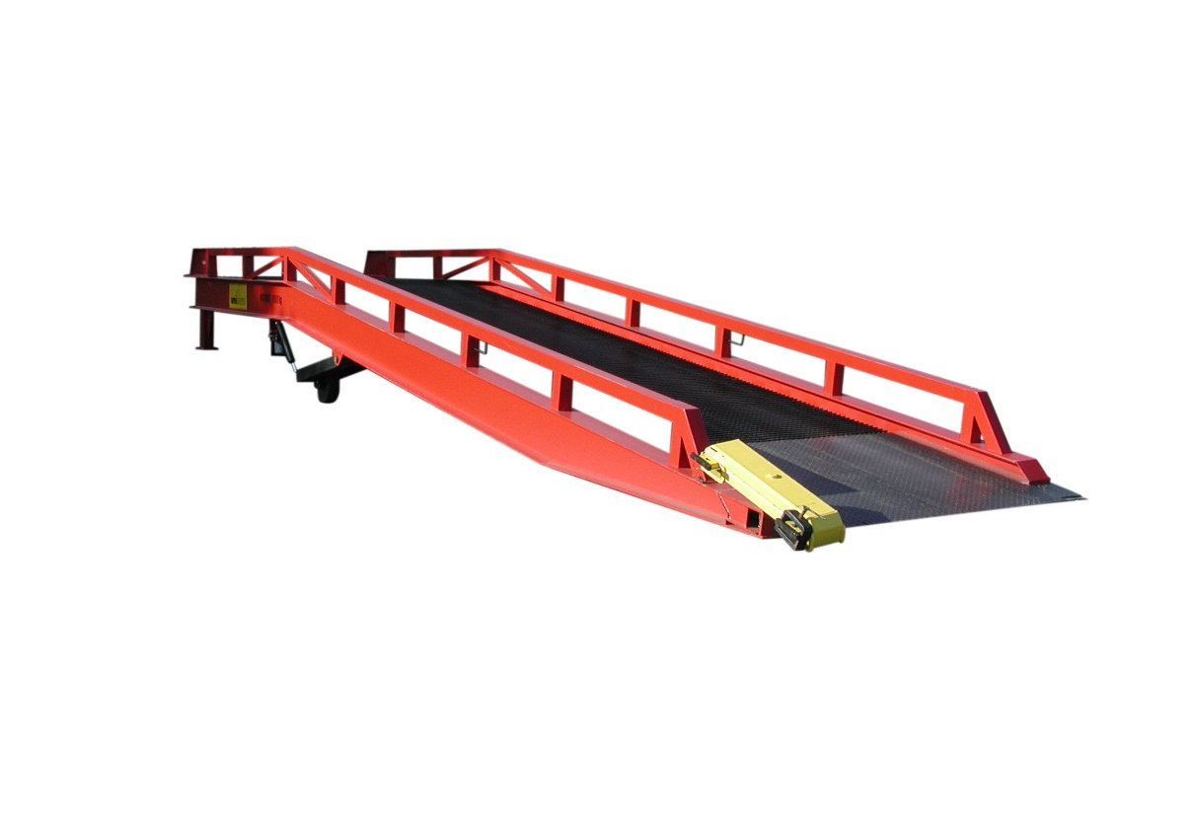
RAMPS

Slide 26
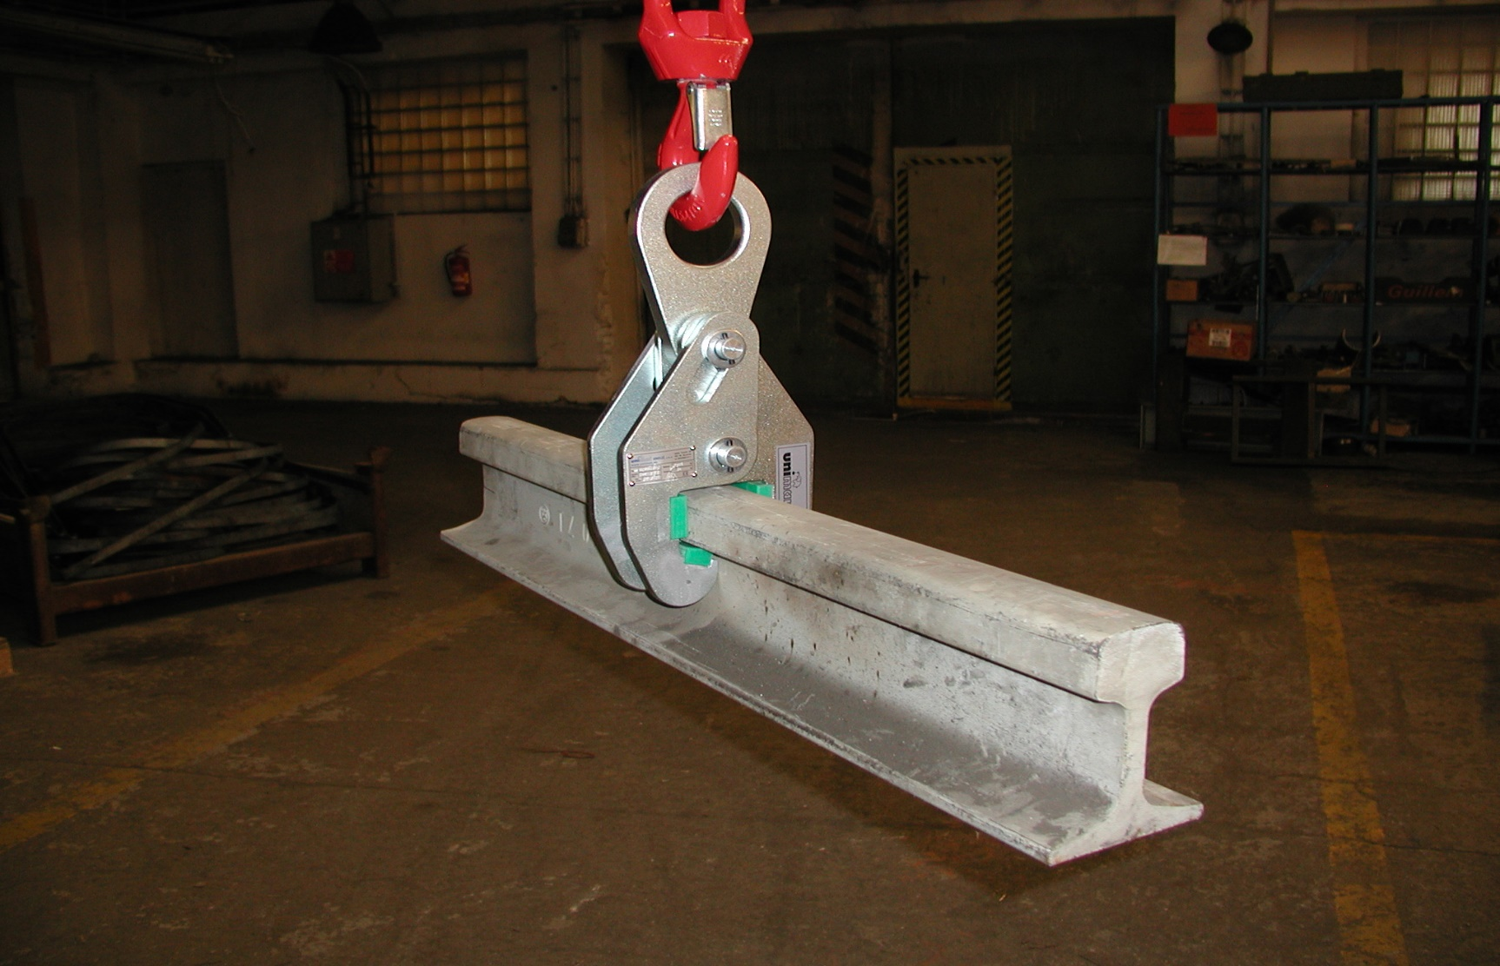
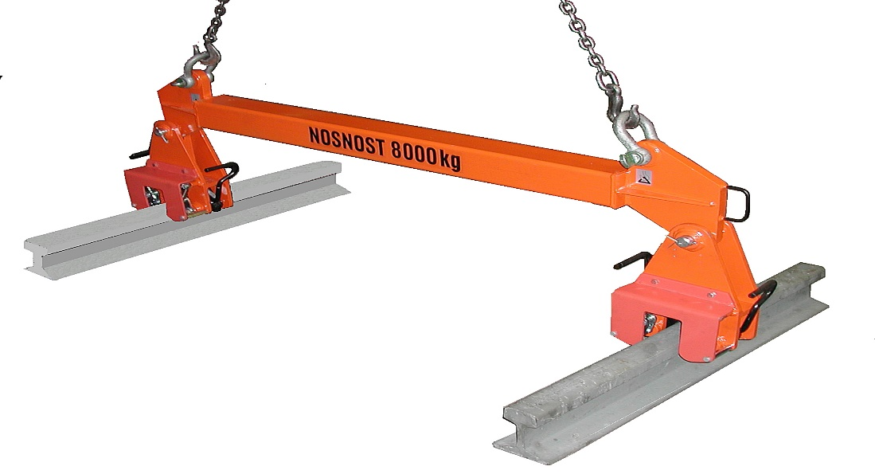
RAIL GRIPPER

Slide 27
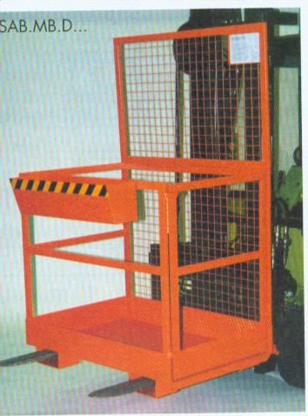
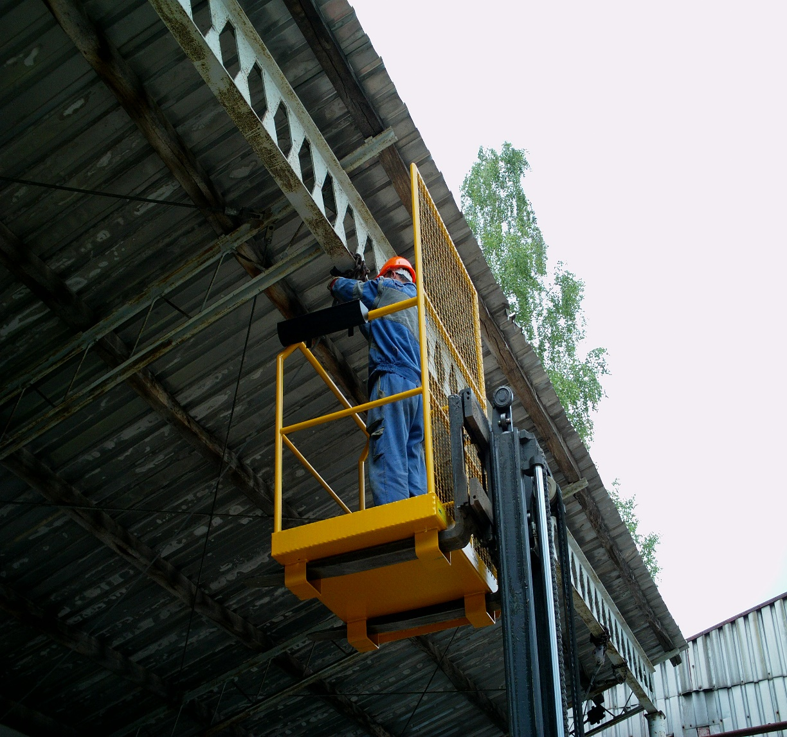
service platforms to fork anD ACCESS BASKETS

Slide 28
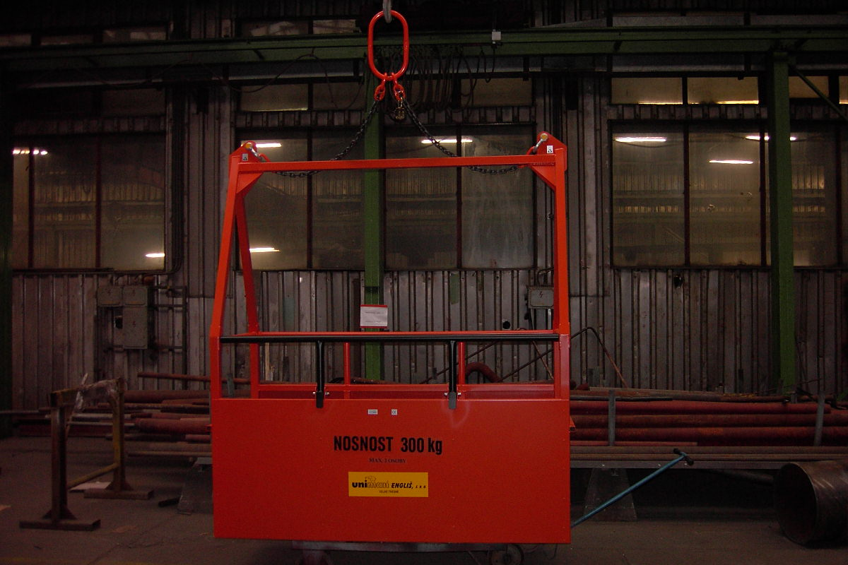
service platforms to fork anD ACCESS BASKETS

Slide 29
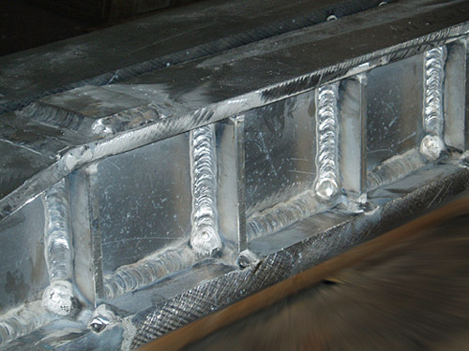
WELDED CONSTRUCTION

Slide 30
www.uniman.eu
UNIMAN Englis, s.r.o.,
Velke Tresne 56, 592 65 Rovecne
uniman@uniman.cz
516 116 711

